Slide 1
TDMA (DMR, TETRA) Power Measurement
Mike Gathergood
Bird Technologies, EMEA
+44 7557 368490
mgathergood@birdrf.com
June 2021

Slide 2
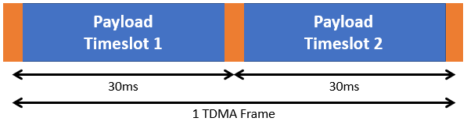
TDMA (DMR, TETRA) Power Measurement
DMR
Rapidly becoming the dominant RF waveform of the Land Mobile Radio industry.
DMR products are manufactured by a wide range of companies, including Motorola (MotoTRBO), Hytera, JVCKenwood, Tait and TPL Systèmes.
DMR repeaters transmit a carrier with two timeslots. The power is still present between the timeslots and frames, so measuring the power is no different from analogue FM.

Slide 3
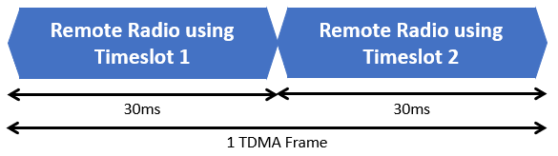
TDMA (DMR, TETRA) Power Measurement
DMR
DMR mobile and handheld radios only transmit during one of the two timeslots.
This is known as TDMA (time division multiple access).
The radio only transmits for approximately 27.5ms of every 60ms frame length, so measuring power is more challenging.
Conventional RF power meter technology will not give an accurate reading.

Slide 4
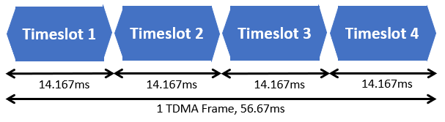
TDMA (DMR, TETRA) Power Measurement
TETRA
Like DMR, TETRA uses Time Division Multiple Access, but with four timeslots.
Each timeslot is 14.167ms long.
As with DMR, a conventional power meter will not give an accurate reading of the power output from a TETRA mobile or handheld radio, as the radio is only transmitting for 14.167ms out of every 56.67ms.

Slide 5
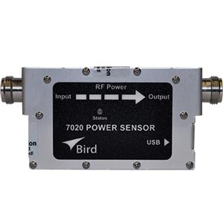
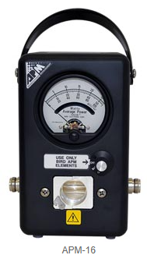
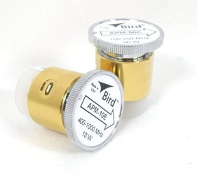
TDMA (DMR, TETRA) Power Measurement
It is therefore important to use a power meter capable of reading true average power, for example:
Bird 7020 RF Power Sensor, 25 to 1000MHz, 0.5 to 500W. Uses VPM3 Windows™ software, or Bird RF Meter Android App.
Bird APM-16 Average Reading RF Power Meter, with appropriate plug-in elements, for example APM-50C for VHF or APM-50D for UHF.

Slide 6
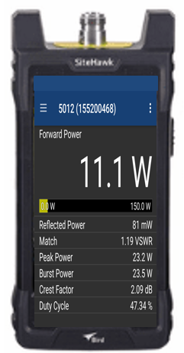
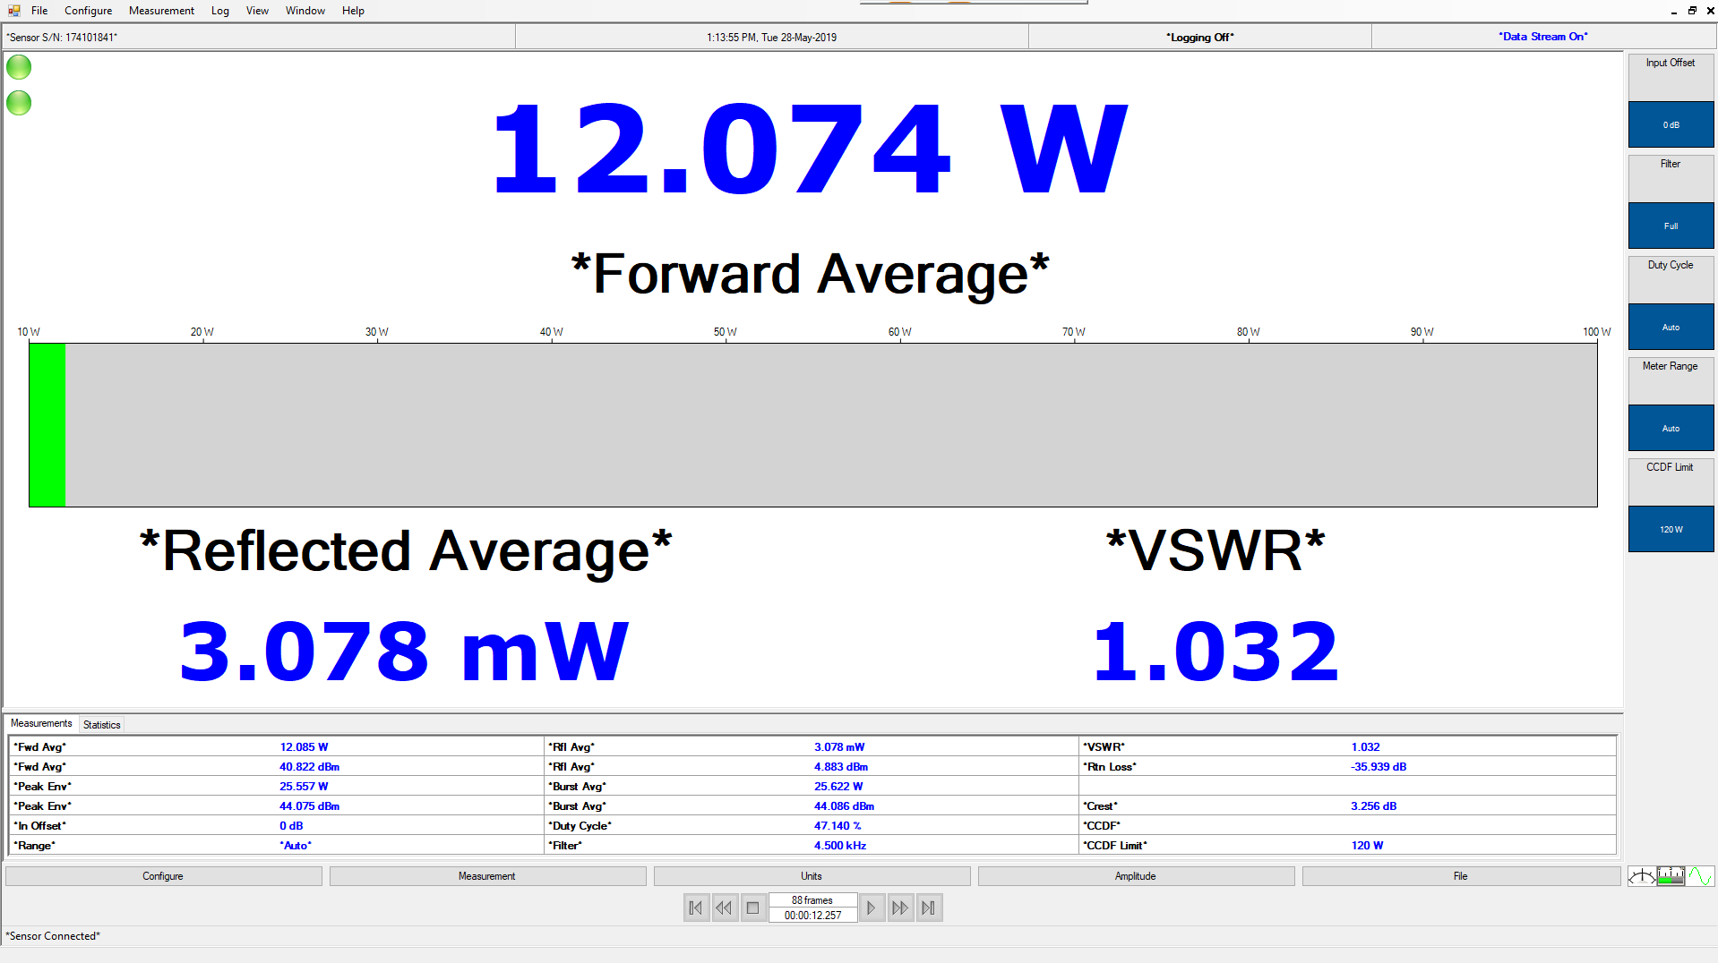
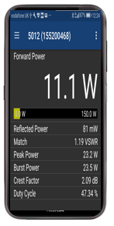
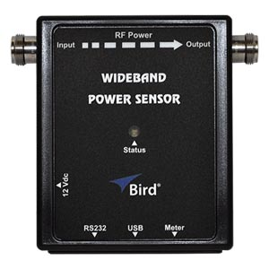
TDMA (DMR, TETRA) Power Measurement
There are also Bird products which can display true average power, peak power and duty cycle of TDMA waveforms, for example the Bird 5017D, for 25 to 1000MHz, 500mW to 500W, 1.3kW peak.
Bird VPM3 Virtual Power Meter Software
Bird RF Power Meter App
SiteHawk
SignalHawk

