Slide 1
Peak Envelope Power Measurement
Mike Gathergood
Bird Technologies, EMEA
+44 7557 368490
mgathergood@birdrf.com
June 2021

Slide 2
Peak Envelope Power Measurement
The most common waveform used for high frequency (2 to 30MHz) voice radio communications is Single Sideband (SSB).
Applications of SSB include:
Maritime ship-to-shore radio communications.
Aviation, especially oceanic routes which are beyond the range of VHF radio.
Military communications.
Commercial communications in developing countries.
Aid agencies working in developing countries.
Amateur (ham) radio.
SSB is also the underlying waveform of a number of other HF radio technologies, including:
FED-STD-1045 automatic link establishment.
MIL-STD-188-141B automatic link establishment.
STANAG 4538 (3rd Generation) automatic link establishment.
MIL-STD-188-110A/B data communications over HF radio.

Slide 3
Peak Envelope Power Measurement
SSB is used because it is more efficient than Amplitude Modulation (AM) in terms of power usage and bandwidth usage.
In an SSB transmitter, the audio and RF signals are applied to a balance modulator, resulting in upper and lower sidebands, but no carrier. One of the sidebands is then filtered out, leaving just the one sideband. Most commonly, the lower sideband is filtered out leaving just the upper sideband (USB). However, lower sideband (LSB) may also be encountered.
In conventional AM, a significant amount of power is “wasted” in the carrier, and in the unnecessary sideband. SSB therefore yields a significant power saving, and a 50% saving of radio bandwidth, compared with AM.
However, there is little or no RF power between speech peaks, meaning that measuring the power of the transmission becomes a little more complicated…
LSB
USB
LSB
USB
USB
LSB
fc
fc
fc
fc
Amplitude Modulation
Double sideband, supressed carrier
Upper sideband, supressed carrier
Lower sideband, supressed carrier

Slide 4
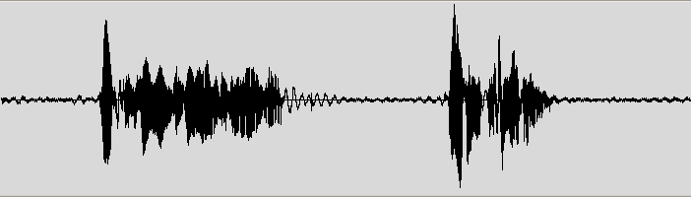

Peak Envelope Power Measurement
The solution is to measure the peak power output, which occurs when the modulating audio waveform is at its highest permissible level. The resulting measurement is referred to as the Peak Envelope Power.
Modulating voltage waveform
Peak Envelope Power, P=V²/R
Resulting RF voltage waveform

Slide 5
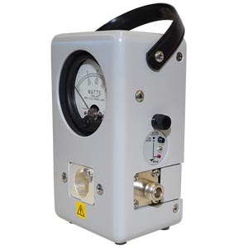
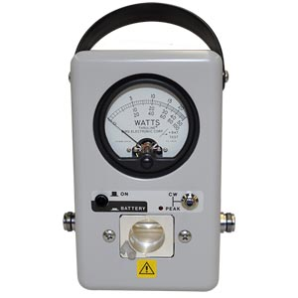
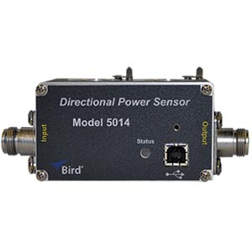
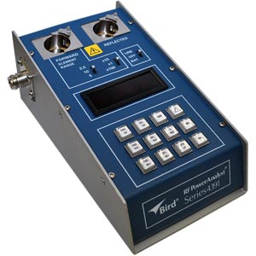
Peak Envelope Power Measurement
When measuring SSB transmitter power output, it is therefore important to use a PEP-capable power meter. These include:
43P General Purpose RF Wattmeter with Peak Reading Option, with “H” series elements.
4314C PEP RF Wattmeter, with “H” series elements.
4391A PEP Dual Element RF Power Analyzer, with “H” series elements.
5014 Directional RF Power Sensor, with “H” series elements, and VPM3 Windows™ software or Bird RF Meter Android app.
H series elements include 25H (25W), 50H (50W), 100H (100W), 250H (250W), 500H (500W), 1000H (1kW), 2500H (2.5kW), 5000H (5kW) and 10000H (10kW).

Slide 6
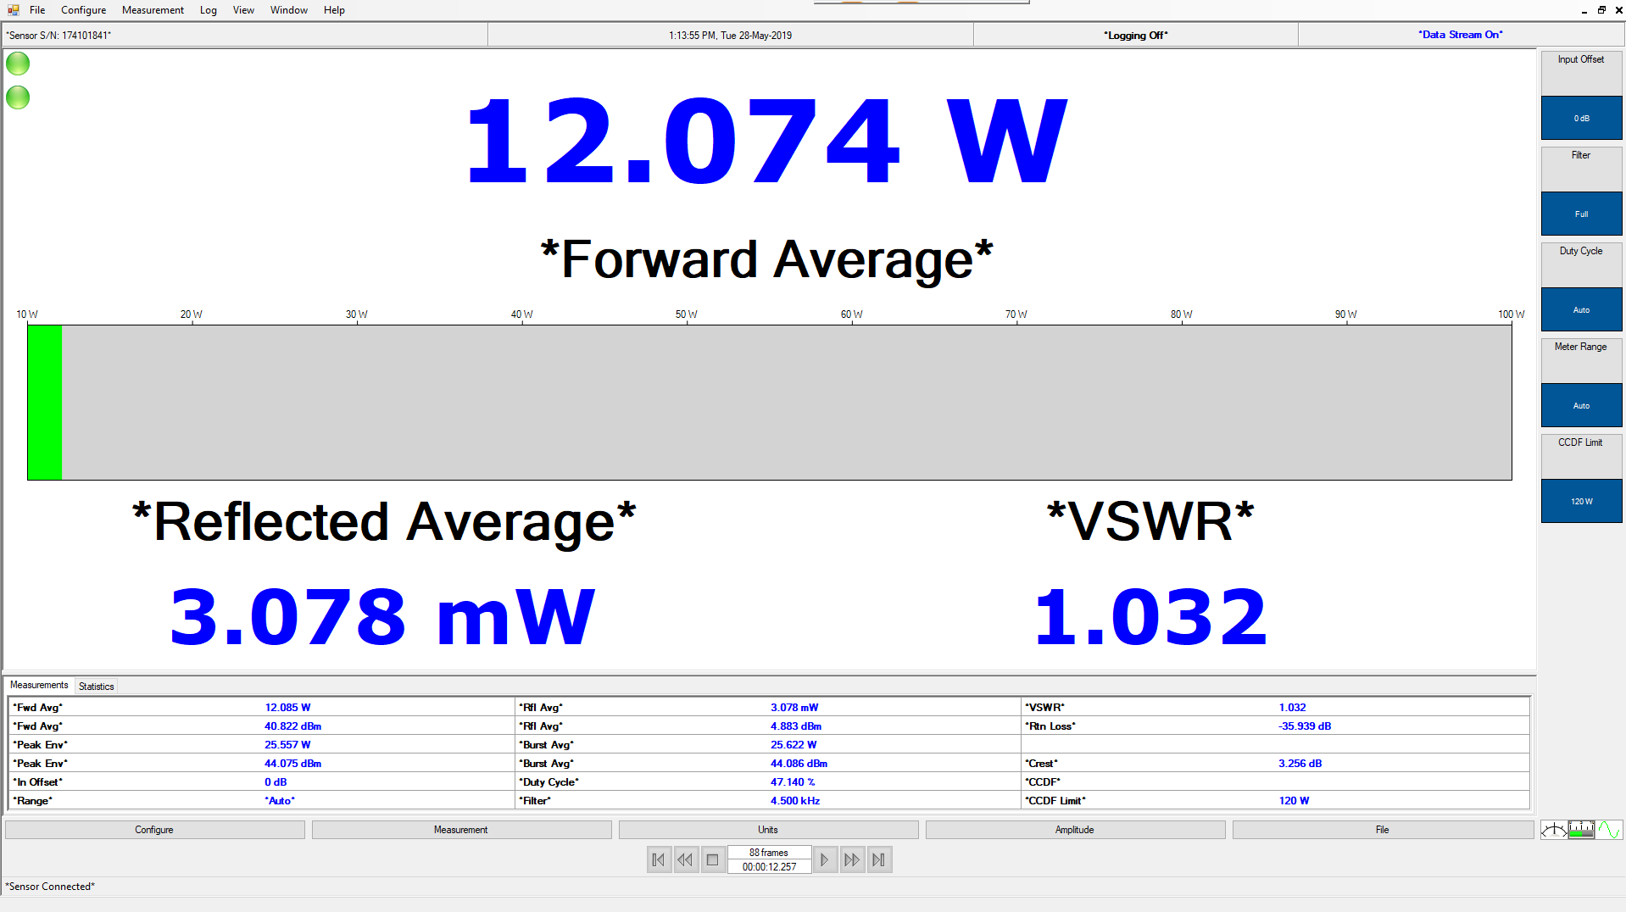
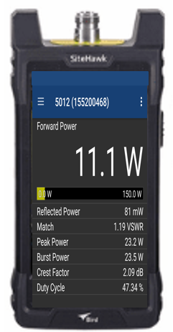
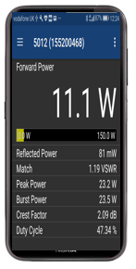
Peak Envelope Power Measurement
Bird VPM3 Virtual Power Meter Software
SiteHawk
FlightHawk
RailHawk
SignalHawk
Bird RF Power Meter App

Slide 7
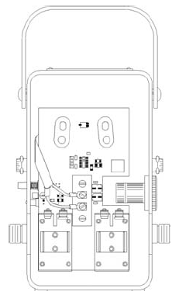
Peak Envelope Power Measurement
It is also possible to upgrade a standard Model 43 General Purpose Wattmeter, to 43P specification, using the 4300-400 retro-fit kit. This can be installed using simple hand tools (no soldering is required) in less than ten minutes.

