Slide 1
Test Equipment for GMDSS Radio Surveys Mike Gathergood Bird Technologies, EMEA +44 7557 368490 mgathergood@birdrf.com February 2021

Slide 2
Equipment for GMDSS Radio Surveys
Bird manufactures products which address a number of key requirements for technicians carrying out GMDSS radio surveys:
Power measurement of HF/SSB and VHF/FM radio equipment
Testing of HF and VHF radio antennas
Testing of coaxial cables

Slide 3
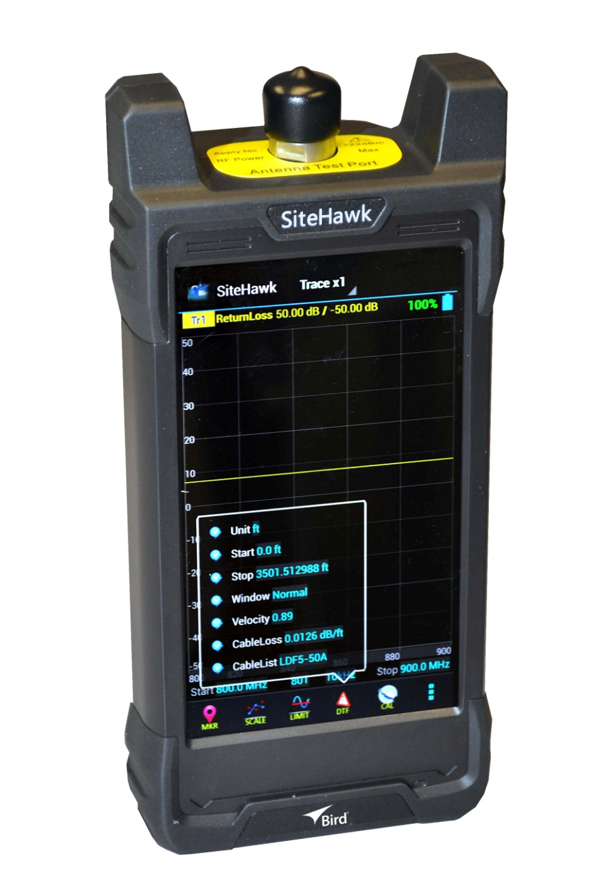
Equipment for GMDSS Radio Surveys
SiteHawk
Compact, self-contained and user-friendly Frequency Domain Reflectometer
Rapid diagnosis of antenna, combiner and transmission line problems
Visual display of VSWR, Return Loss, Cable Loss and Distance-to-Fault
2 models available: SK-4500 (1-4500MHz) or SK-6000 (1-6000MHz)
Long battery life, typically 10 hours between recharges
Also functions as precision RF power meter with optional sensor
3 year warranty

Slide 4
Equipment for GMDSS Radio Surveys
SiteHawk
USB, WiFi and Bluetooth interfaces, for sharing files with other devices
Scans can be exported at CSV (for analysis in Excel, for example), or in proprietary S1P format for post processing with (free) SiteHawk PC software
Screenshots can be exported as jpg or png

Slide 5
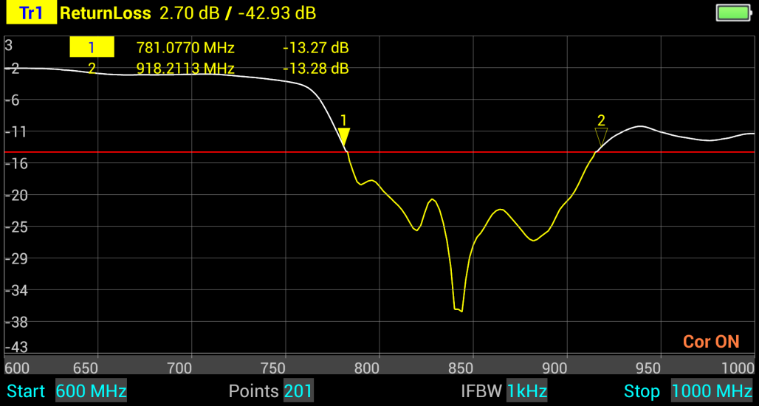
Equipment for GMDSS Radio Surveys
SiteHawk – Return Loss Measurement

Slide 6
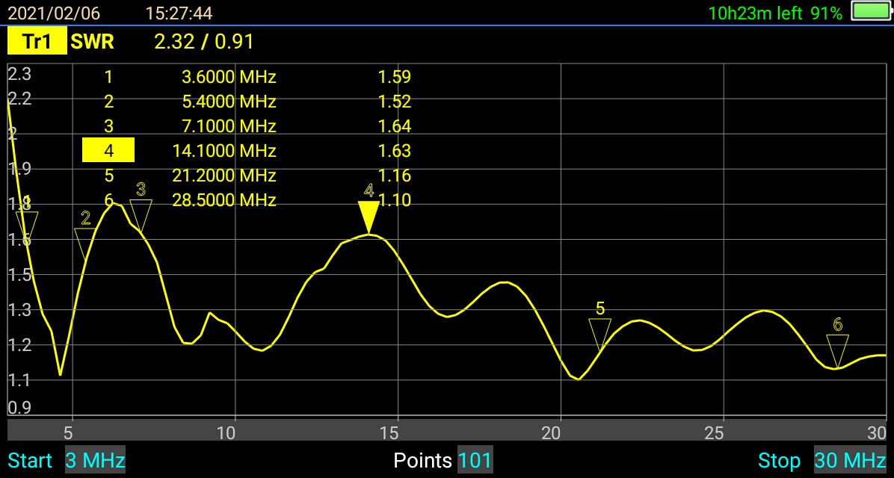
Equipment for GMDSS Radio Surveys
SiteHawk – VSWR Measurement

Slide 7
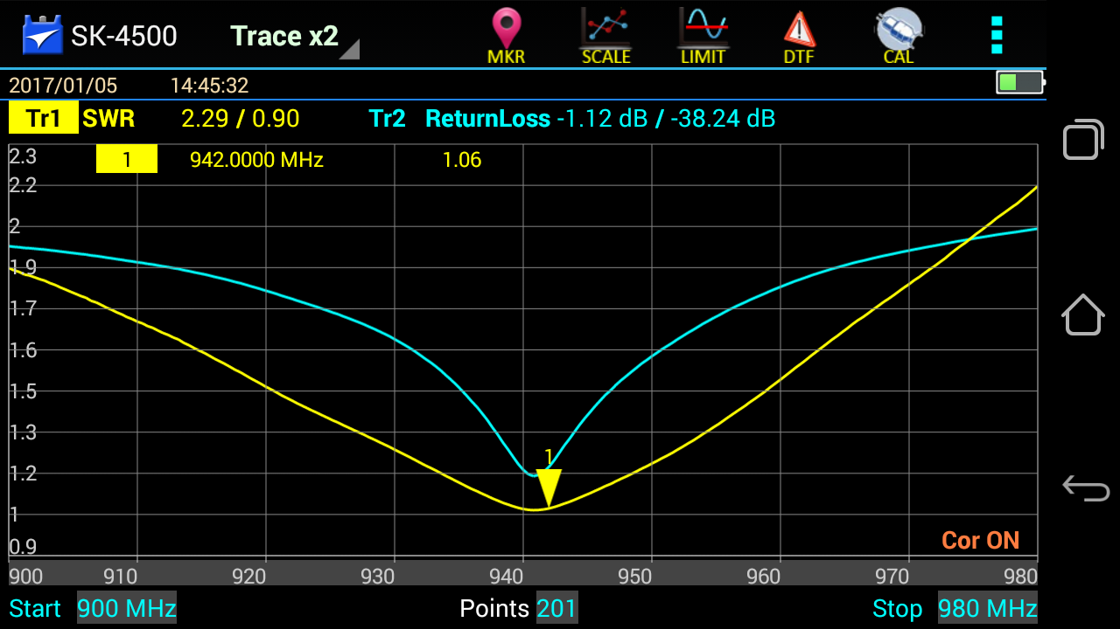
Equipment for GMDSS Radio Surveys
SiteHawk – Multiple Displays

Slide 8
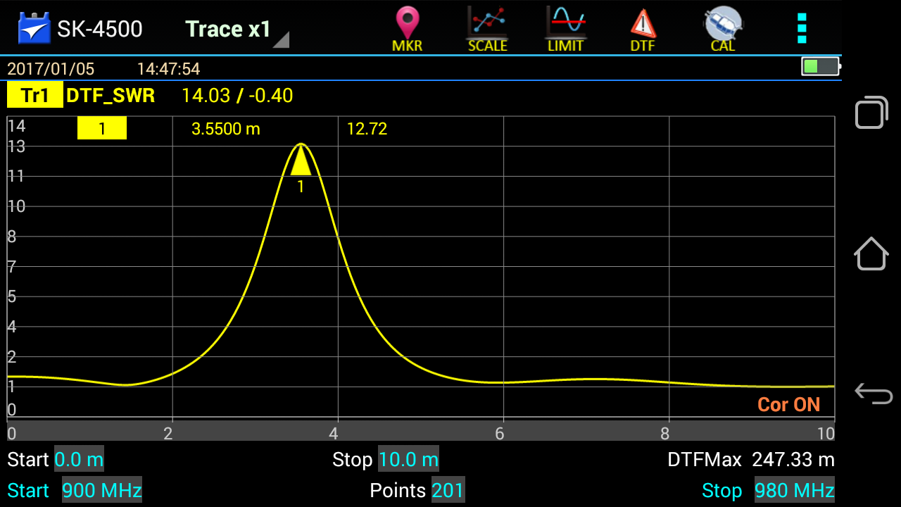
Equipment for GMDSS Radio Surveys
SiteHawk – Distance to Fault Measurement, SWR Mode

Slide 9
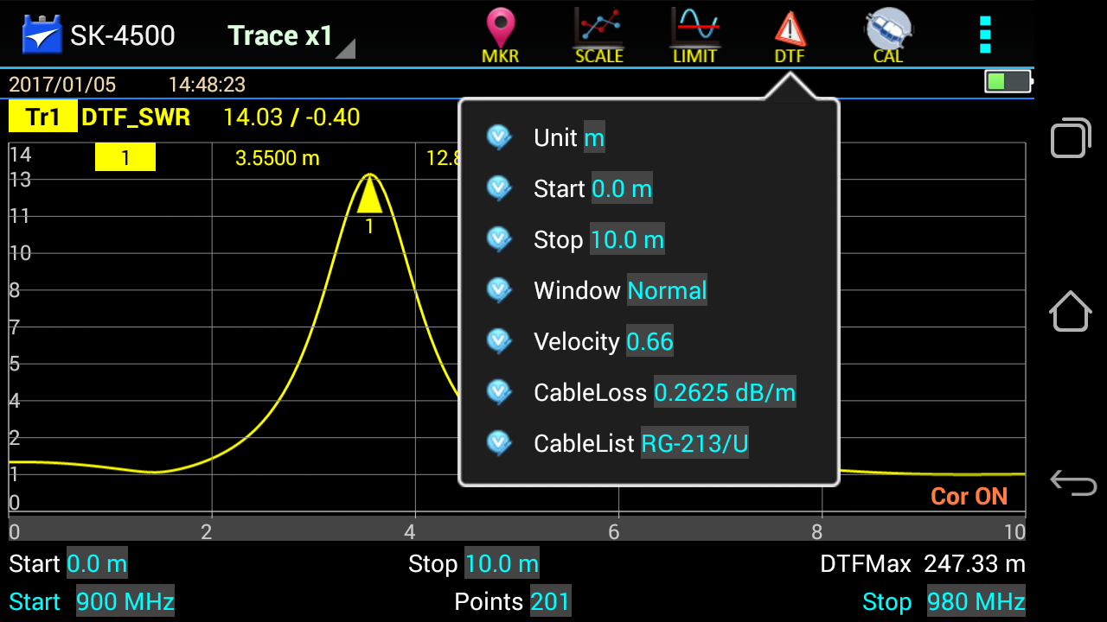
Equipment for GMDSS Radio Surveys
SiteHawk – Distance to Fault Measurement – DTF Menu

Slide 10
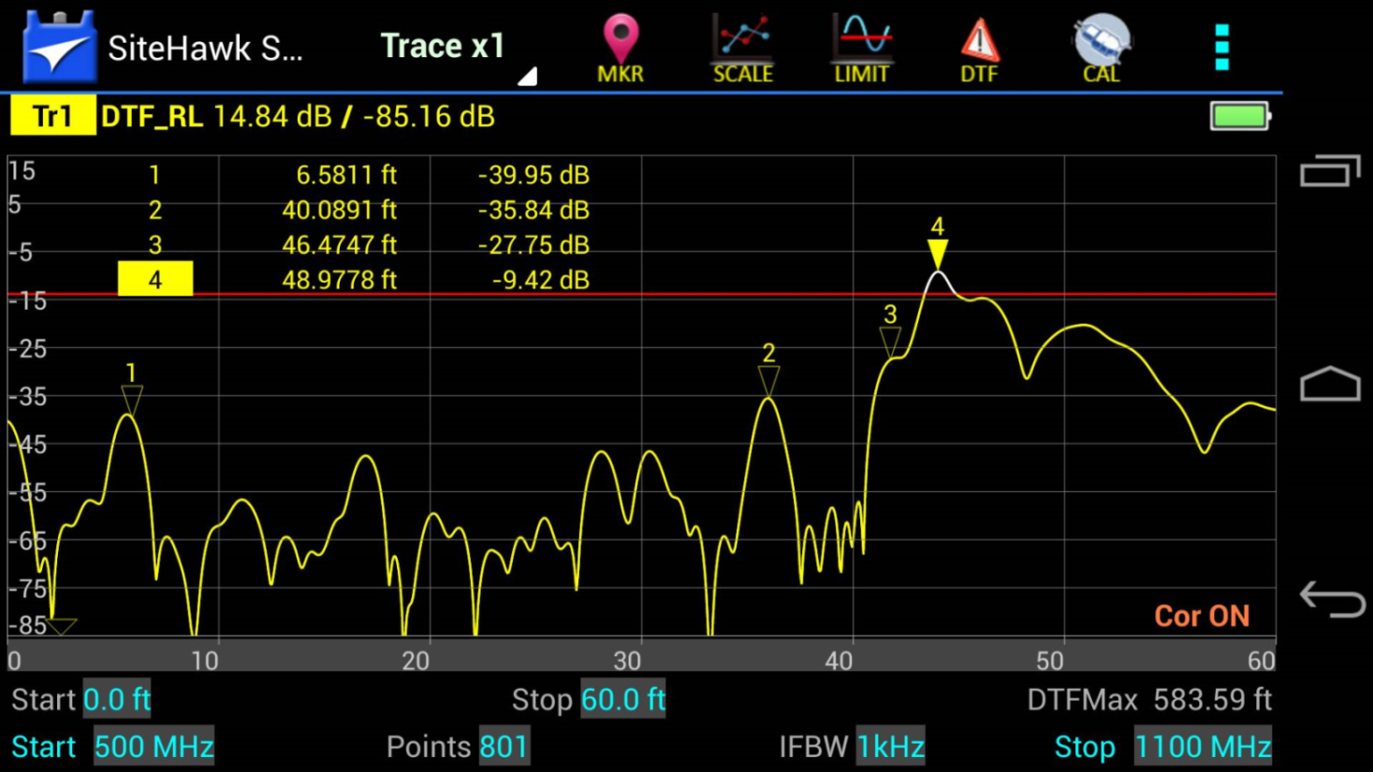
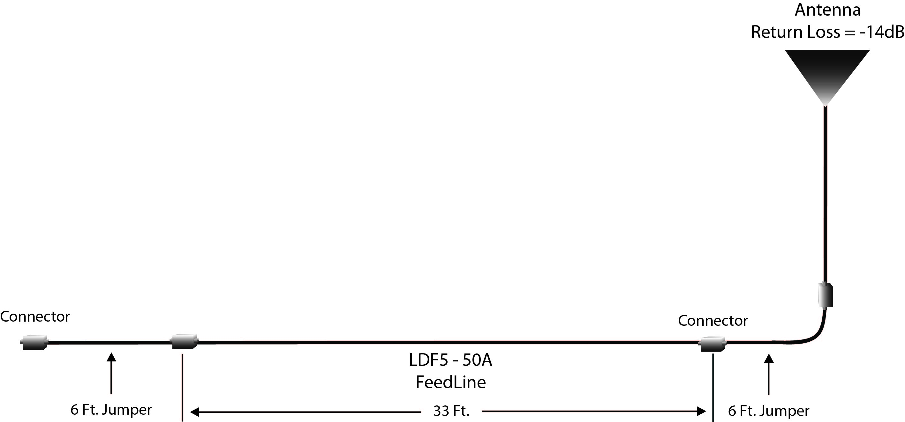
Equipment for GMDSS Radio Surveys
SiteHawk – Distance to Fault Measurement – Return Loss Mode

Slide 11
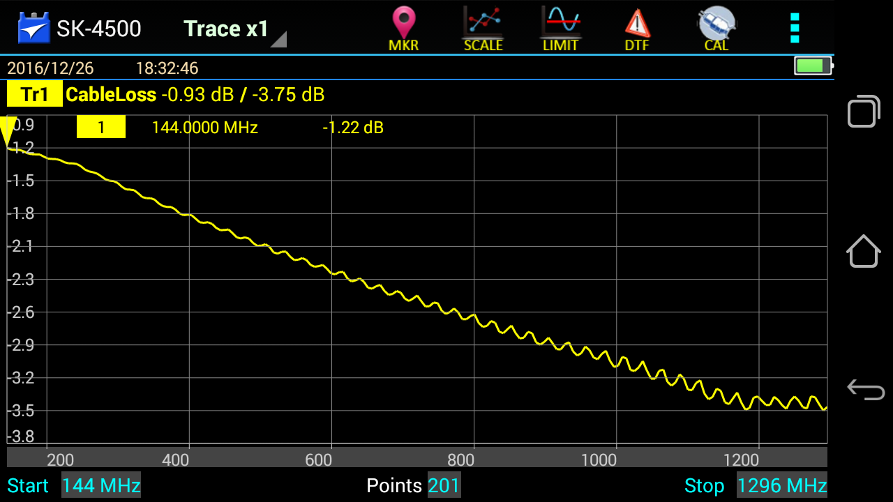
Equipment for GMDSS Radio Surveys
SiteHawk – Cable Loss Measurement

Slide 12
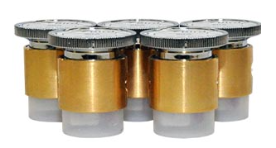
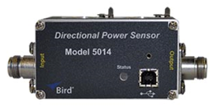
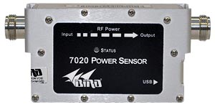
Equipment for GMDSS Radio Surveys
SiteHawk – use as a Precision RF Power Meter
Works with a range of RF power sensors, covering 2MHz to 4GHz
Two models of 7020 Series self-contained sensors for 25MHz to 1GHz, and 350MHz to 4GHz
5014 sensor works with “elements” for other frequencies
5014 with 500H and 50H elements for MF/HF SSB, and DPM-50C and DPM-5C elements for VHF FM radios

Slide 13
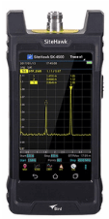
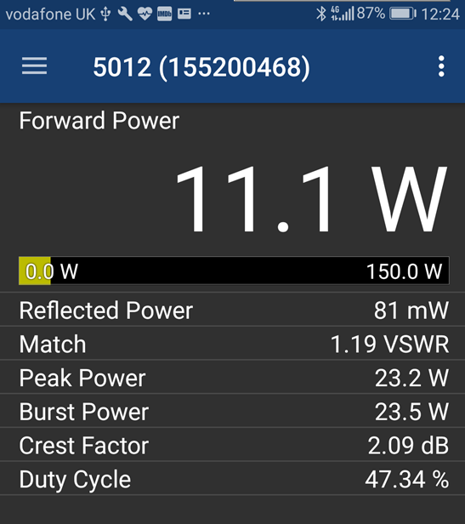
Equipment for GMDSS Radio Surveys

Slide 14
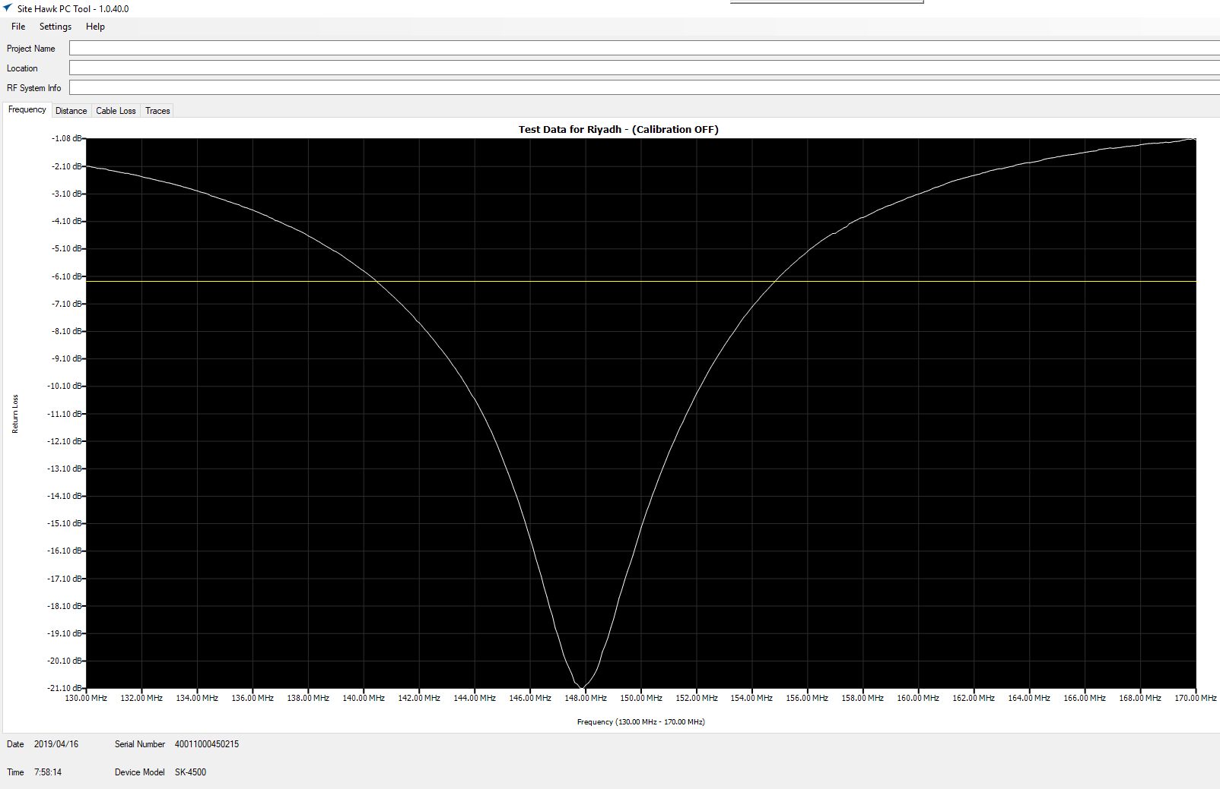
Equipment for GMDSS Radio Surveys
SiteHawk PC Tool Software (free download from Bird website)

Slide 15
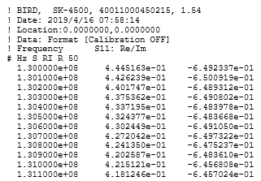
Equipment for GMDSS Radio Surveys
Exported S11 Parameters
Frequency (Hz)
“Real” part of impedance
“Imaginary” part of impedance

Slide 16
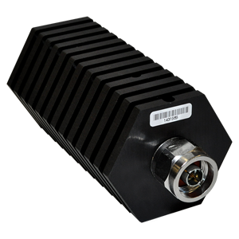
Equipment for GMDSS Radio Surveys
50Ω Loads
50-T-MN is a 50W load with N male connector
Other loads available, from 2W to 80kW

Slide 17
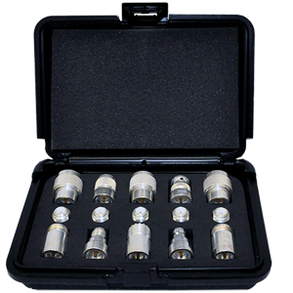
Equipment for GMDSS Radio Surveys
Coaxial Adapter Kits
4240-400 kit caters for N, BNC, TNC and UHF (SO-239 and PL-259)
Other kits available for SMA, 4.3/10 DIN and 7/16 DIN

