Slide 1
RF Interference
Mitigation Strategies using Wideband Signal Recording

Slide 2


Agenda
Interference in Many Forms
Use Cases and Need for Interference Testing
Challenges with Traditional Approaches
Alternative Approaches to Long-Duration Interference Testing
Case Studies
Tools for Interference Testing
Mitigation Strategies
Summary
X-COM Systems LLC™

Slide 3


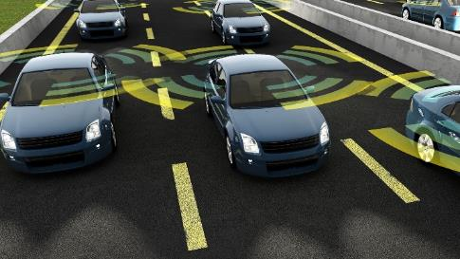

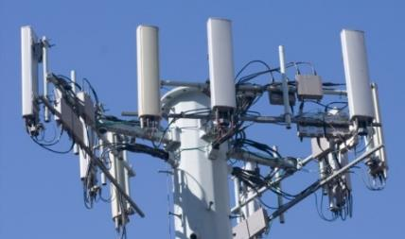
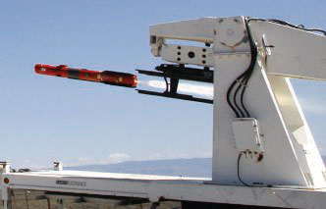





The Need for Interference Testing
System
Interoperability
Radio
Conversations
SIGINT
Telemetry
Links
Spectrum
Monitoring
Flight
Range Ops
Required: Seconds, Minutes or Days of Seamless RF Signal Capture

Slide 4
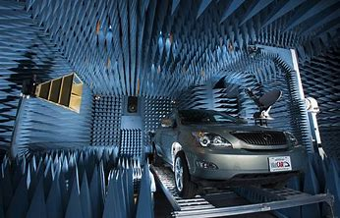
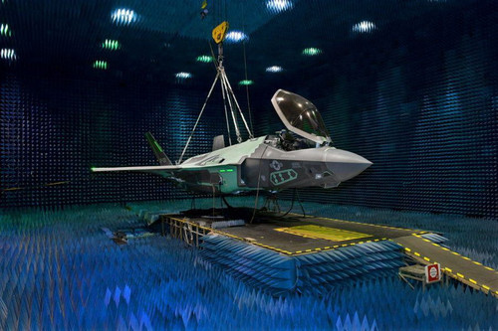
Need for RF Record & Playback
Difficult to detect or predict signals of interest
  Unauthorized emissions
  Unpredictable interactions (Interoperability) in complex RF environments
Streamed signals are information
  Undeniable proof of what happened
  Use data to find other data
  Modify and replay recordings to stress and margin test receivers
  Characterize precise behavior in multiple domains
  Terabyte memories provide capture times from minutes to days
Next Generation Smart Transportation Testing
Image Courtesy of University of Waterloo, Ont. World-class facility that could lead to the creation of new wireless technologies for use in smartphones, cars, healthcare, and more. . .
Lockheed Martin F-35 Joint Strike Fighter

Slide 5



Interference Emanates in Many Forms
RF Record & Playback Need for Interference Identification
Not sure of signals to look for:
  “Desired” signals well understood (Normalizing – Baselining)
  “Problem” signals exist in many forms (Shouldn’t be there)
Need to discover RF signal anomalies
  Characterize precise behavior in multiple domains
  Terabyte memories provide capture times from minutes to days
Critical to create signal archives
  Compare to previous events
  Manipulate and re-transmit signals
Identifying RF Fingerprint
Cannot Always Model or Capture Anomalies in the Lab

Slide 6
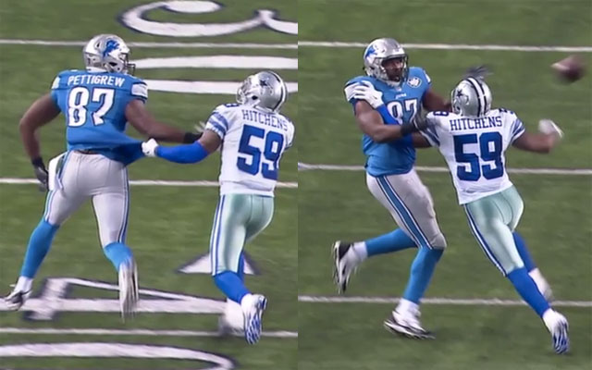
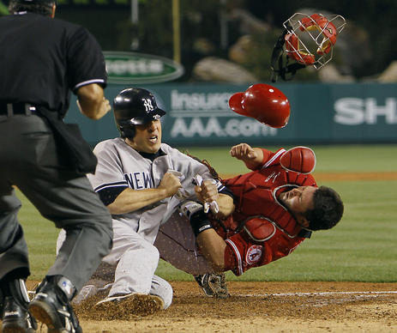
Interference
Photo: Courtesy of CBS Sports
\ˌin-tə(r)-ˈfir\ : to hinder or impede; come into collision or be in opposition

Slide 7


Goals of Interference Testing
  Interoperability
  Design Compliance – vendor adherence to a published standards
  Margin Testing - Receiver performance in presence of interference
Compatibility
  Operational Compliance – Transceiver performance in the presence of other mission critical RF assets
  Impacts from and on other RF assets

Slide 8
Interference In Many Forms
Out-of-Band
In-Band
Culprits
Co-Channel
Adjacent Channel
PIM and Rx De-sense
Harmonics/Spurs
Deliberate Jamming
Culprits
Co-Channel
Adjacent Channel
PIM and Rx De-sense
Harmonics/Spurs
Deliberate Jamming
High Power Tx
Victim
In
Channel
Out of
Channel
Fundamental
Jammer
Harmonic
Adjacent
Channel
Co-Channel
Intermodulation
Noise Floor

Slide 9

Challenges with Traditional Approaches
Signal Analyzer Block Diagram
(simplified)
Display
Preselect
Down-
Convert
Digitize
Store
Process
RF
Input
ADC
DSP
RAM
µP
Continuous Processing
Batch
Processing
Real-Time LVDS Interface
Monitoring stops while the receiver is post-processing
Events lasting longer than the available memory are lost
Trigger settings valid only for one set of conditions
If the system fails to capture the event, it’s gone forever

Slide 10
Interference Testing – Workflow
Alternative Approach
Signal Capture
Analyze and Simulate
Signal Playback
Data Formatting
& Storage
Signal Analysis & Signal Creation
RF Down Conversion
Waveform Digitization
Waveform Generation
RF Up Conversion
Vector Signal Analyzer w/ Streaming IQ Interface
  Broad frequency coverage
  Wide acquisition bandwidth
  High dynamic range
IQ Data Recorder
  Real Time Data Tagging
  High Speed Offloading
  Data Protection
Visualize & ID Signals
Replay Very Large Files
Create New Signals from
Original Data
Convert Digital IQ to Analog
Vector Signal Generator
  Broad frequency coverage
  Wide bandwidth IQ
  High dynamic range
100% Capture, Analysis, Simulation and Replay RF Data

Slide 11
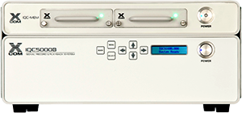
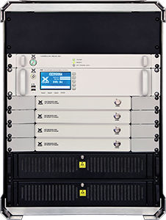
HW Tools for Interference Testing
IQC91000A RF Record & Playback System
1000 MHz IQ record and playback bandwidth
1 GHz to 18 GHz frequency coverage, 26.5 GHz and 40 GHz option available.
90 minutes of continuous record and playback time.
IQC5000B RF Record & Playback System
  40, 165, & 255 MHz IBW
  16-bit Low Voltage Differential Signaling (LVDS) interface
  Built-in IQ and fixed RF playback
  IRIG-B and GPS Inputs
  Triggers and Markers
  Memory
    Internal: 50 min @ 255 MHz
    External: 3 hours @ 255 MHz
  Single and Dual Channel
  Utilizes RSA for down conversion & digitization
High-speed data offload for post-processing in MATLAB® as well as other popular VSA tools.
Sophisticated triggers and markers to time-tag and geo-tag signal events.
Eliminate gaps and only record signals of interest by leveraging gated trigger capability.

Slide 12
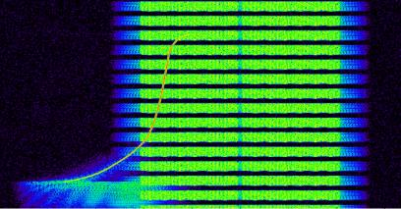
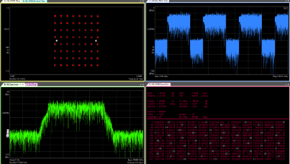
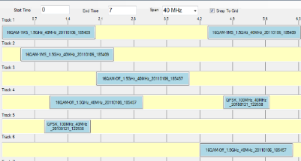
SW Tools for Interference Testing
Spectro-X Signal Analysis Software
  Visualize stored data as a “Motion Picture”
  Search engines to ID and fingerprint waveforms
  “Clip and Save” for replay in VSA SW
Vector Signal Analysis Software
  Supports over 75 standards and modulation types
  Bit-level modulation analysis
RF Editor Signal Creation Software
  Create new signal scenarios from recorded files
  Clip, stitch, translate, filter and loop waveform libraries
Spectro-X Analysis
VSA Software
RF Editor Software

Slide 13

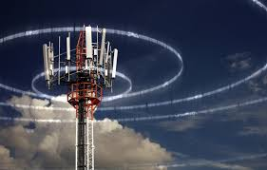

Use Cases for Interference Test
#1. Record in theater & playback in the lab
  Characterize the nature of interference
    100% capture provides understanding of who, what, when and where
    Record environment at victim and culprit locations simultaneously
    Extract and post-process interesting portions from long-duration captures
  Replay and Simulate environment using real-world signals
    Test receiver in presence of interference
    Evaluate mitigation techniques

Slide 14
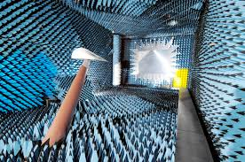
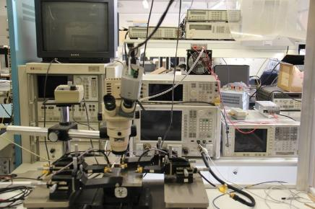
Use Cases for Interference Test
#2. Record in the lab & playback in the lab
  Compatibility testing during long-duration integration test
  Anechoic chamber and direct inject measurements

Slide 15
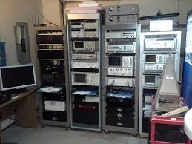
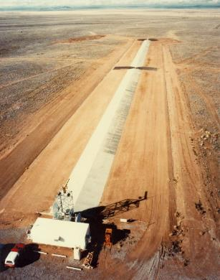
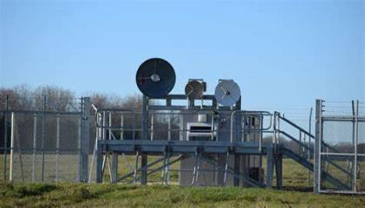

Use Cases for Interference Test
#3. Create in the lab & playback on the range
  Interoperability testing
  Single and multi-channel environment simulation
  Communication Regulation Organizations
    Spectrum Management
  Disaster Relief Organizations
    Communication Effectiveness
  Space Exploration Agencies
  Science & Technology Agencies
  CERN Hadron Collider
    Black Matter Research
    Axion Particle Research

Slide 16
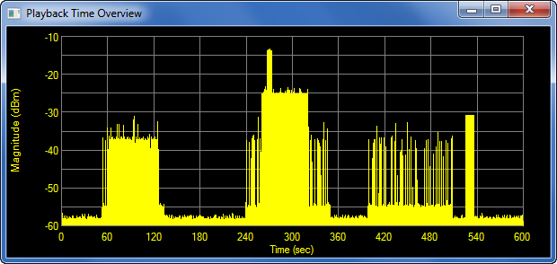
Case Study – Bluetooth, Linear FM Chirps
10 Minutes of Continuous Capture
Visually Inspect for Interference
Zoom into Interesting Time Ranges
Signal Process
Region #2
Region #1
Region #3
Spectro-X

Slide 17
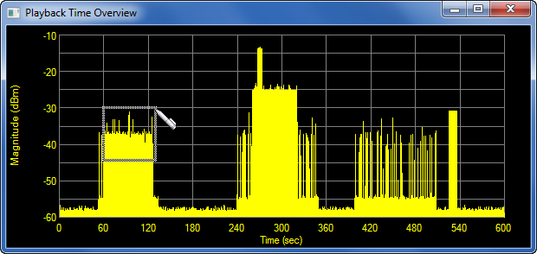
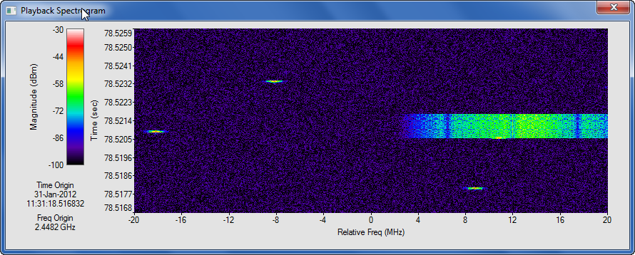

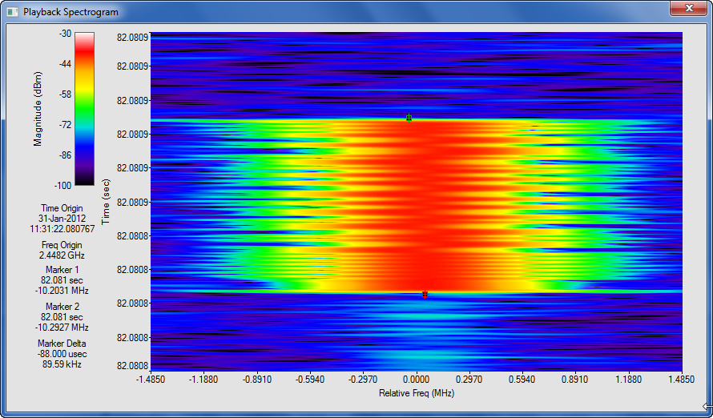
Case Study – Region 1
Time Overview
Select Time of Interest
Spectrogram
Zoom on Signal of Interest
Zoomed
Spectrogram
IEEE 802.11b
Analyze Signal of Interest
88 µs
Question: How often do signals like this one occur?

Slide 18

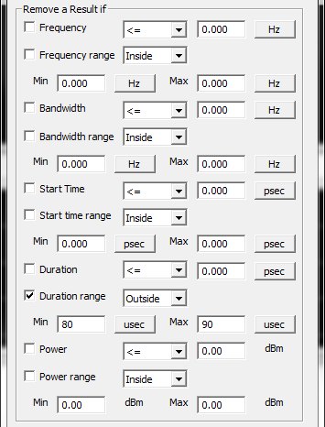
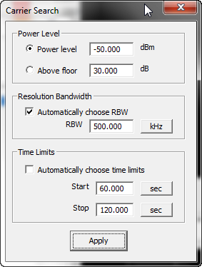
Case Study – Region 1 Interference
Carrier Search
  Finds all signals above a specified power threshold
  Prune results to isolate signals of interest
Sort on Signal Characteristics
Find Everything

Slide 19
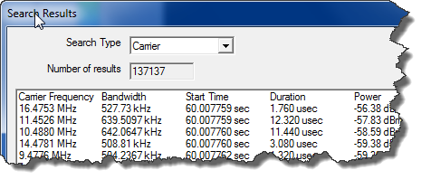
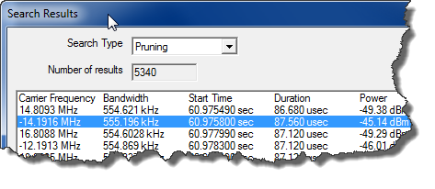
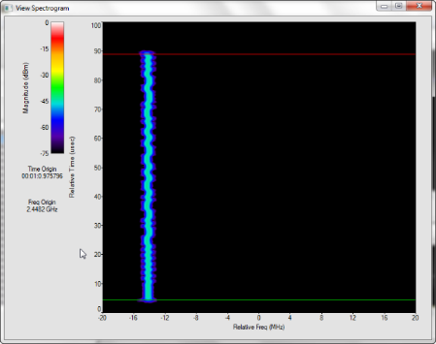
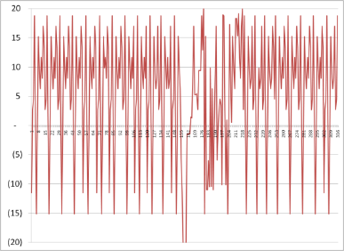

Case Study – Region 1 Interference
Carrier Search
  137,000 total carriers found over time range
Search Pruning
  5,000 matching our criteria for hopping radio
  Center Frequency
  Bandwidth
  Start Time
  Duration
  Power
Spectrogram for each result
Hop Freq vs. Time
10.2 Seconds

Slide 20
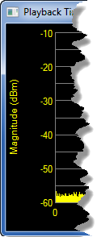
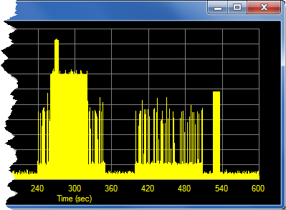
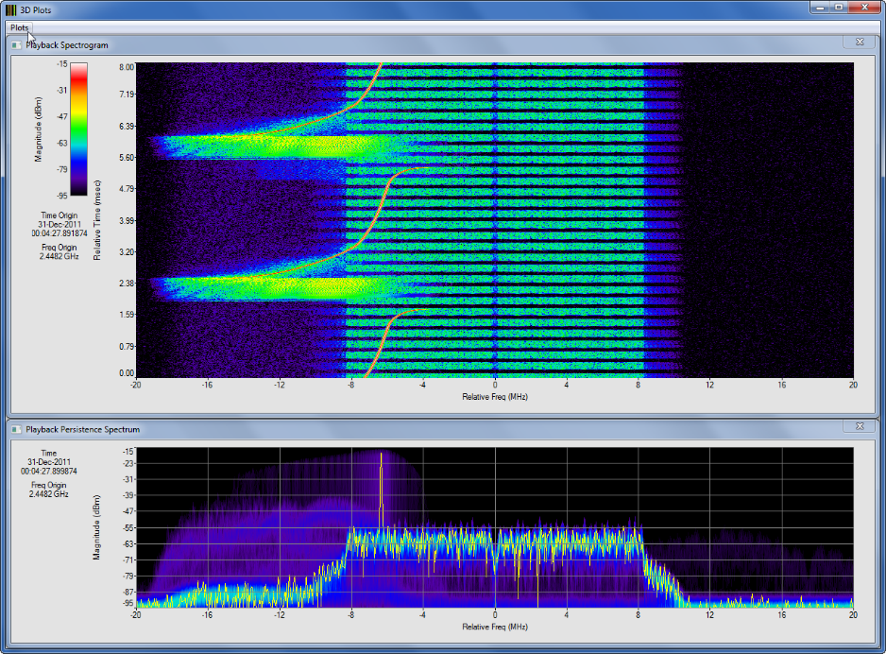
Case Study – Region 2 Interference
Time Overview
Culprit Easy to See
Region #2
Questions:
What is the interfering signal?
What is the impact on the 801.11g signal
quality?

Slide 21
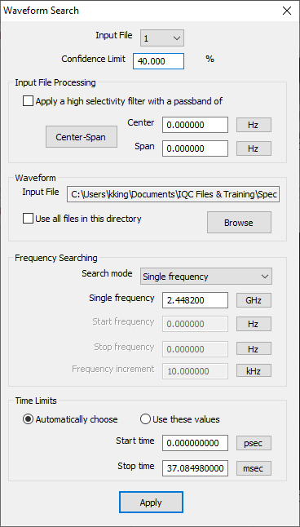
Case Study – Region 2 Interference
Waveform Search
  Correlate training sequence in wireless standards
  User-definable carrier frequency and correlation
  Stepping allows searching “near” specified carrier frequency

Slide 22
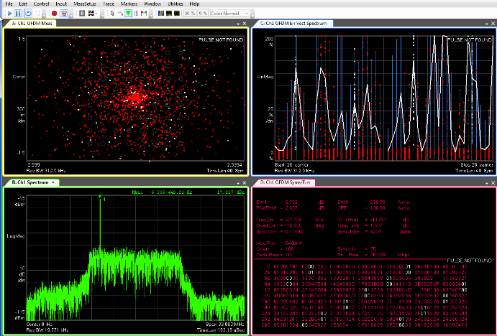
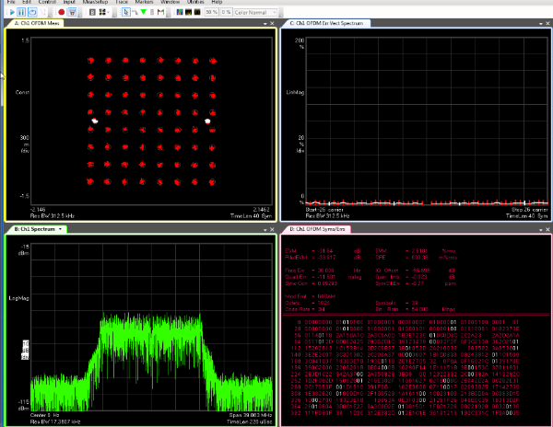

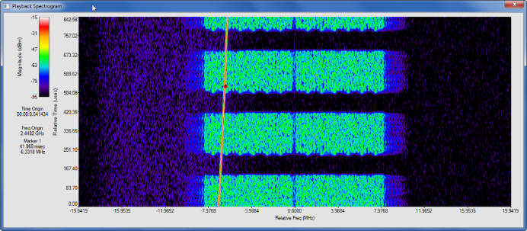

Case Study – Region 2 Interference
Time during Interference
Time before Interference
45 dB
Spectro-X Spectogram
Extract Portions of Dataset for Time-Correlated Vector Signal Analysis with VSA Software

Slide 23
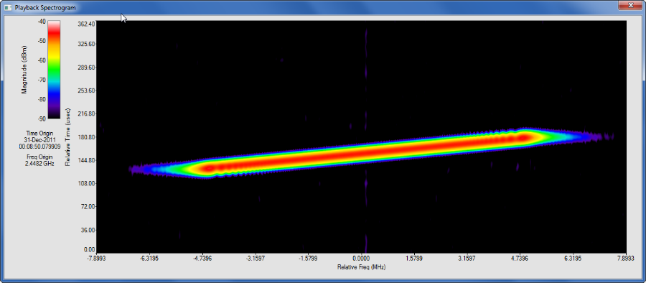
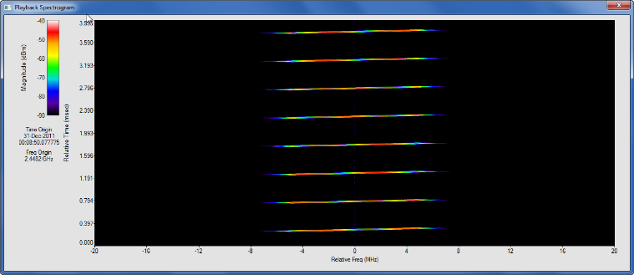

Case Study – Region 3 Interference
Time Overview
Questions:
How many instances occurred?
Which ones are not like the others?
Region #3
Zoomed Spectrogram
Spectrogram
Zoom on Signal of Interest
Signal appears to be a 10 MHz LFM Chirp

Slide 24
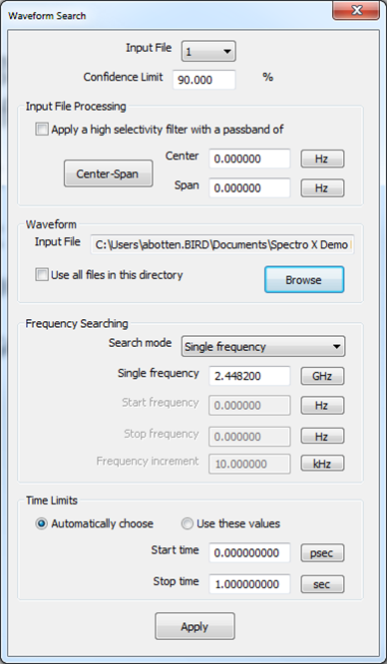

Case Study – Region 3 Interference
Waveform Search
  Find occurrences of signals that look like a reference waveform
  Reference can be extraction from data set or simulated (e.g. MATLAB)
  User-definable correlation and carrier frequency
Reference Waveform

Slide 25
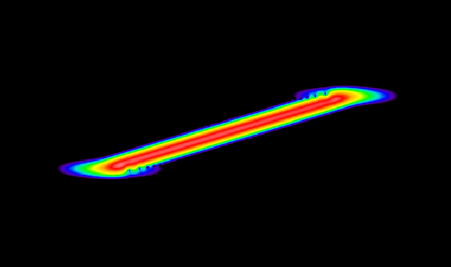
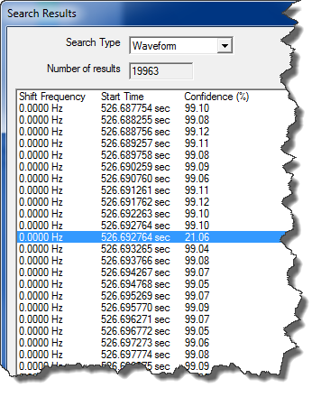
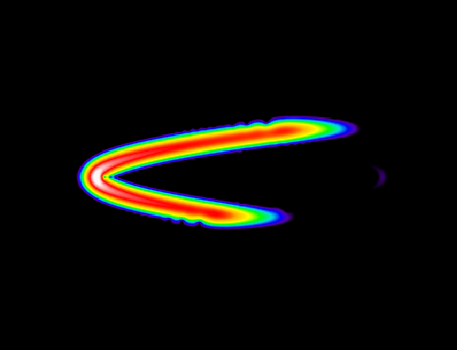
Case Study – Region 3 Interference
Waveform Search
  20,000 occurrences matching the reference
“Good” Pulse 99% Correlation
“Bad” Pulse 21% Correlation

Slide 26
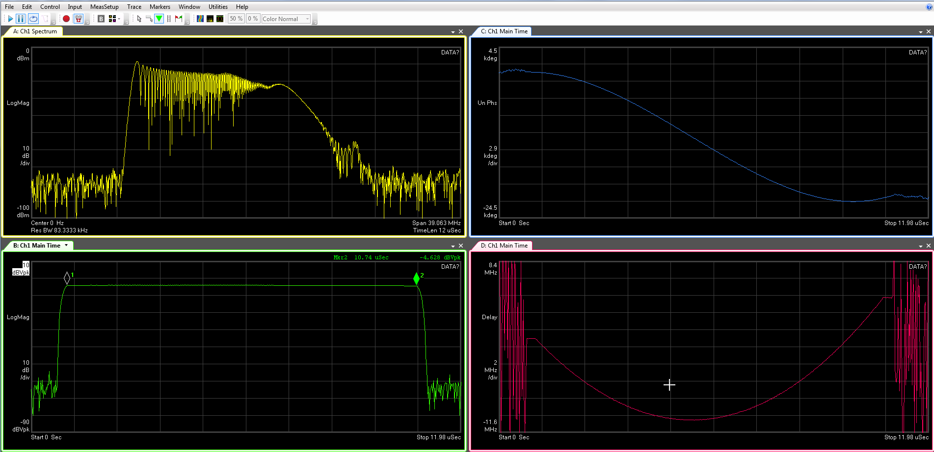
Case Study – Region 3 Interference
Export pulse to VSA SW to show why it's different
Spectrum
Phase v Time
Amplitude v Time
Freq v Time

Slide 27
Case Studies – Interference Results
Region #2
Region #1
Region #1
Region #3
  Found 137,000 total carriers
    Pruning extracted frequency agile radio with 5,000 hops
    Hopper operated for 10.2 seconds starting 11:31am
    Hop pattern was extracted and plotted using Excel
Analyze Signal of Interest

Slide 28
Case Studies – Interference Results
Region #2
  Identified an 802.11g transmission
    Interferer began disrupting communications at 11:34 am for 5 seconds
    VSA analysis found that EVM went from 2.6% when interference was not present to nearly infinite when the interferer was present
Region #2
Region #1
Region #3

Slide 29
Case Studies – Interference Results
Region #3
  Located 20,000 occurrences of an arbitrary carrier that looked like an LFM radar chirp
    Correlation analysis found that one pulse looked different (21% match) at 11:38:46.692am
    VSA analysis found that this was a 10.7us wide non-linear chirp
“Good” Pulse 99% Correlation
Region #2
Region #1
Region #3
“Bad” Pulse 21% Correlation

Slide 30

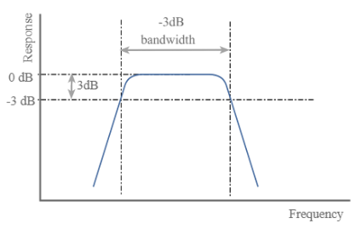

Mitigation Strategies
Filtering – Improve receiver preselection
Shielding – Reduce impact of culprit radiation
Spatial Separation – Take advantage of path loss
Re-banding – Find compatible open channels
Temporal Compliance – Timing of culprit and victim
PIM Studies – ID interference and use hand-held tools to locate
Margin Testing – How much is enough to mitigate interference effects

Slide 31

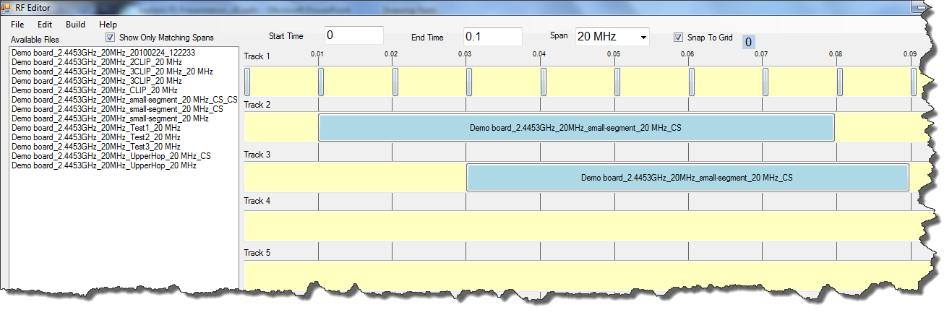
Tools – Signal Editing and Creation
Create composite IQ file
Loop segments at specific intervals
Filter signals to reduce transition transients
Choose Recordings
From Library
Independent, parallel tracks can be precisely time synchronized
Add frequency shifted copies of original signal
Build New Scenarios from Existing Recordings

Slide 32
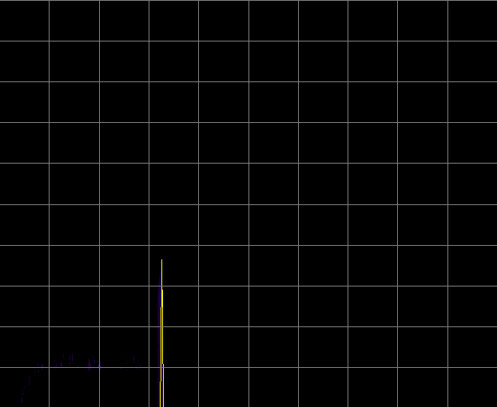
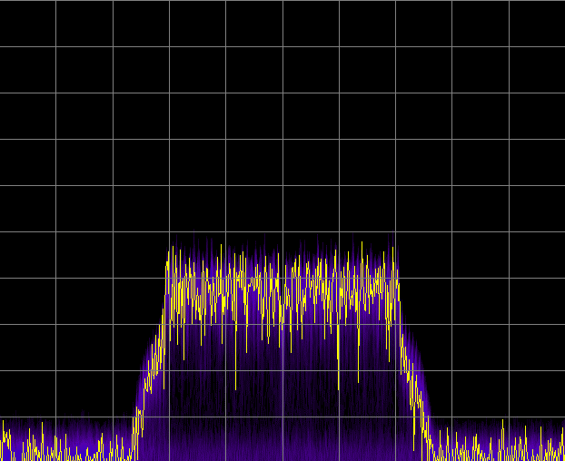
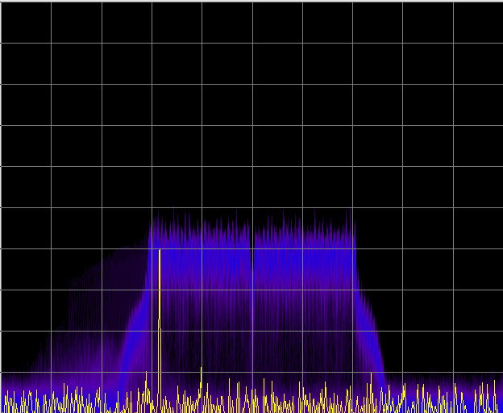
Mitigation Example for 802.11g Interference
Extract time segment of “good” WLAN operation (no interference)
Overlay the interference waveform
Build new signal environment to simulate and test
  Attenuate culprit
  Sum with “good” WLAN signal
  Simulate scenario and replay into victim receiver
Original Level
+
=
Test Level
48 dB Attenuated Culprit
Good WLAN
Composite Signal

Slide 33
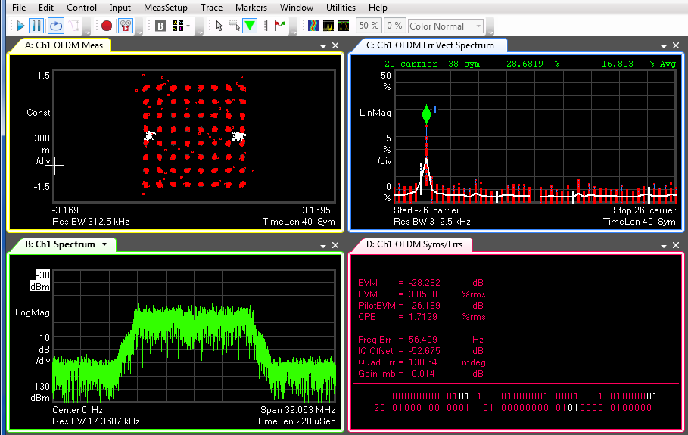
Mitigation Example for 802.11g Interference
EVM still impacted, but worse-case acceptable

Slide 34
Mitigation Example for 802.11g Interference
Create RF Environments using Recorded Waveforms
  IQC5000B – formats the data for replay at baseband
  IQC5000B – converts signal from digital IQ to analog IQ
  VSG – up converts the IQ waveform to carrier frequency
Signal Capture
Analyze and Simulate
Signal Playback
Data Formatting
& Storage
Signal Analysis & Signal Creation
RF Down Conversion
Waveform Digitization
Waveform Generation
RF Up Conversion

Slide 35

Interference Testing Summary
Interference Comes in Many Forms
  Not always easy to see or determine the culprit
  Alternative approaches may be required
Signal Processing Tools are Often Required
  Understand the nature of the interference
  Understand its impacts on system performance
Captured Interference is Information
  Provide undeniable proof of what actually happened
  Use to stress and margin test victim receivers
Photo: Courtesy of Flickr.com

Slide 36

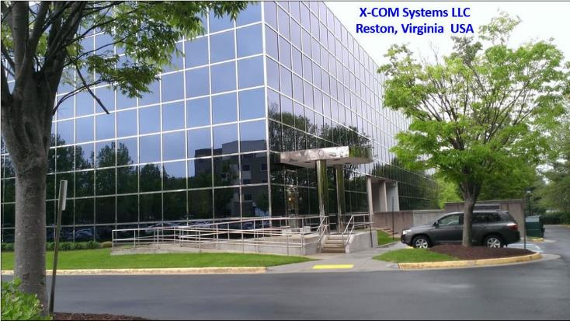

Sales & Applications Contacts
X-COM Systems LLC
_{A Bird® Company}
SALES
Julian Parker
(571) 612-5490 (office)
(703) 297-6055 (mobile)
julian.parker@xcomsystems.com
High Speed
RF
Data Capture | Analysis
Detection | Generation
APPLICATIONS ENGINEERING
Alex Botten
(571) 612-5486 (office)
(571) 334-3193 (mobile)
alexander.botten@xcomsystems.com

