Slide 1
Distance to Fault Measurements

Slide 2
Training Agenda
Segment 2:
Today’s Webinar Topics
What is Distance to Fault?
Set up for Distance to Fault
What do I need to know?
How to interpret a sweep
Tips and best practices

Slide 3

Questions from Segment 1
One of the poll questions from last week asked:
“Can anyone add to the list of - What causes an impedance mis-match?”
Here are some of responses:
Recessed center pins on connectors due to non-captivated center pins
Incorrect antenna length can lead to mismatches
Incorrect connector on hardline cable will affect system
Cattle or rats chewing the feeders!
Staple through a coax.. (residential tv cable)
EMI/RFI adds to loss
Ice Damage/Ice Build Up
Shield contacting center pin
Nail in the line
Water in the line
Forest Fire
An antenna that is not resonant
for all the great responses!

Slide 4
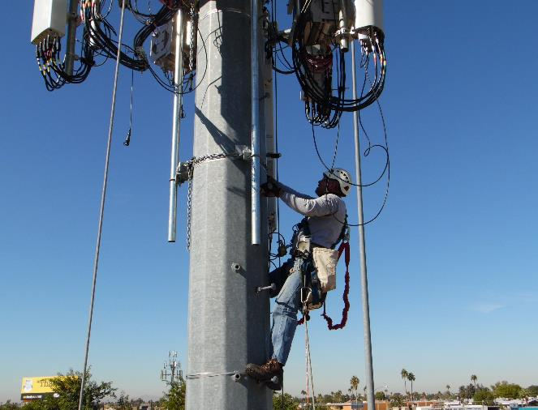
Distance to Fault - What is it?
Distance to Fault (DTF)
Is a measurement of how far from the test point a fault occurs.
Instead of “hand-over-hand” checking of the feed line up a tower, the analyzer will give a distance to the problem or fault.
The field technician might still have to climb the tower, remove ceiling panels in a building, and crawl thru tight spaces, but he/she will have a much smaller area to check to find the fault.

Slide 5
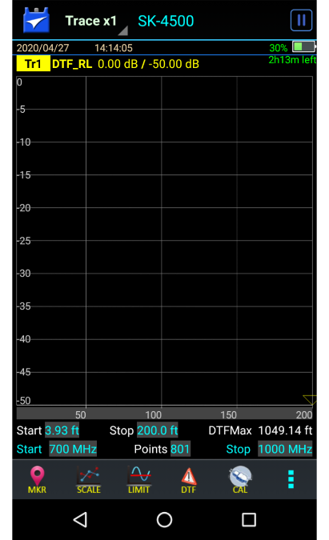
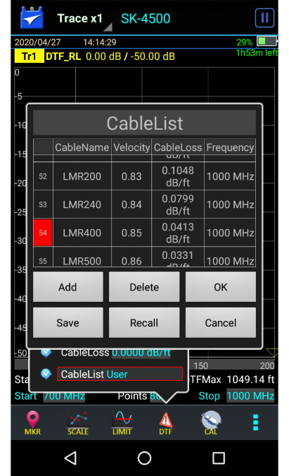
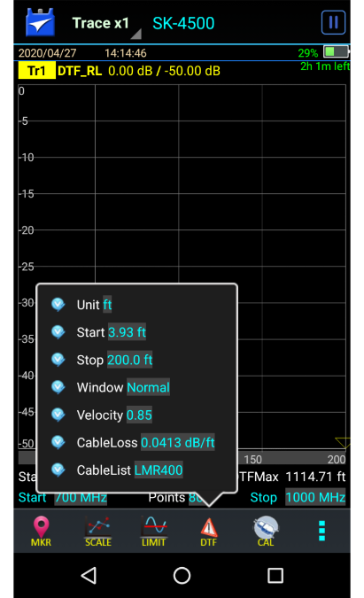
What information do I need to know?
Frequency Range of the system
Cable Type
Total Length of your system
Diagram of your system is helpful

Slide 6
Frequency Range
Frequency Range of the system.
When performing distance to fault or DTF sweeps, widening the frequency range results in a display with more detail visible.
When measuring a transmission line (no frequency sensitive components attached), a large frequency span is desired to help highlight potential faults or areas of performance degradation.
When measuring an antenna system (with antenna and/or lighting protection attached), the operating frequency range must be used.

Slide 7
Frequency Range Tips
The greater the frequency span of measurement, the more detail will be seen in the display.
The greater the frequency span of measurement, the smaller the maximum distance that can
be measured.
The maximum distance is inversely related to the frequency span of the measurement.
In general, the frequency range should be selected for optimum resolution
  Without exceeding the frequency range of attached components.
  While maintaining a distance large enough to see all antenna system components.
  Add approximately 10-20% to the known cable length.

Slide 8
Cable Information
Cable Type – There are two cable parameters needed - Velocity of Propagation and Cable Loss.
Velocity of Propagation, is the reduction in signal speed as radio waves travel through a medium other than free space. It is also known as Velocity Factor. Entered incorrectly, it affects the distance of a DTF sweep.
Cable Loss – This is how much power is being lost within the line or in individual components. It may also be called Insertion Loss, Cable Loss or Attenuation, and it is a manufacturer’s specification. Entered incorrectly, it will affect the amplitude of a DTF sweep.
Entering the wrong Velocity of Propagation or Cable Loss is cumulative with cable length, and becomes more pronounced with distance, meaning the further away from the test port the more error that is introduced.

Slide 9
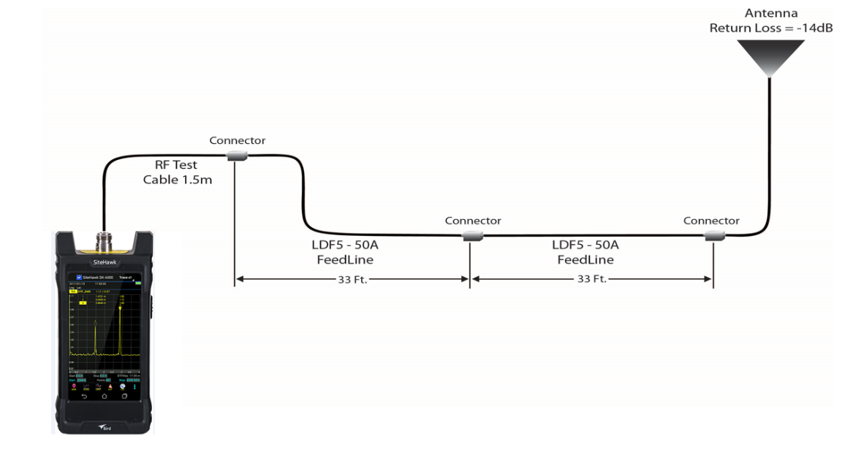
System Diagram
Diagram of your system – Helpful, but not always possible. Without a diagram it is difficult to tell what you are looking at, and anything you see is a guess.
Total Length of your system – add 10-20% to the stop distance. This will allow the entire system and all components to be displayed on the analyzer.

Slide 10
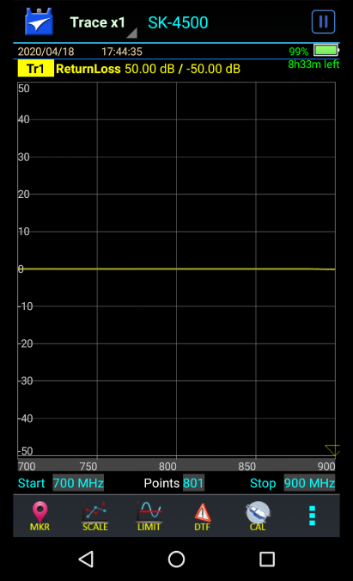
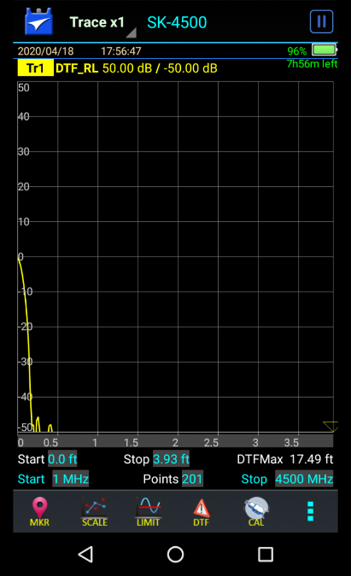
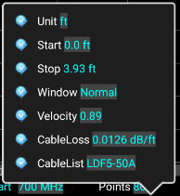
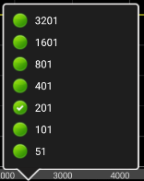
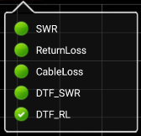
Setup for Distance to Fault
Select DTF Mode by tapping here.
Set Frequency Range – wider than the system requires.
Select number of data points.
Set DTF info.
Units – meters or feet
Stop Distance – add total length of system including
antenna and add 10-20%.
Enter Vp and CableLoss manually
or Select cable type from CableList to populate
Vp and CableLoss fields automatically.
Calibrate

Slide 11
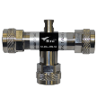
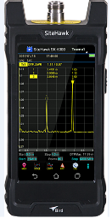
Calibration Tips
CALIBRATION TIP:
Use a test cable in your measurements.
Adding a test cable allows you to extend the test port to reach those hard to get to places.
The addition of a test cable, or changes in the length of the test cable, will affect readings taken in Distance to Fault measurements.
When using a test cable calibrate to the end of the cable.
Calibrate here, measurement begins here.
Cal combo
1.5m RF Test Cable

Slide 12
Typical Values
Measure Match/Return Loss VSWR vs Return Loss in dB
VSWR
Return Loss
Description
1.5:1
-14dB
Antenna at Resonance
1.12:1
-25dB
Connector
1.04:1
-35dB
Jumper
1.12:1
-25dB
Lightning Arrestor
1.06:1
-30dB
Feed Line

Slide 13
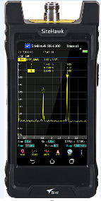
Interpreting Sweeps
DTF Test System Diagram
Antenna
Return Loss = -14dB
Calibrate here, measurement begins here.
20 ft
Connector
Connector
Connector
LDF5-50A
Feedline
LDF5-50A
Feedline
RF Test
Cable 1.5m
33 ft
33 ft
Total system length = 86 ft.

Slide 14
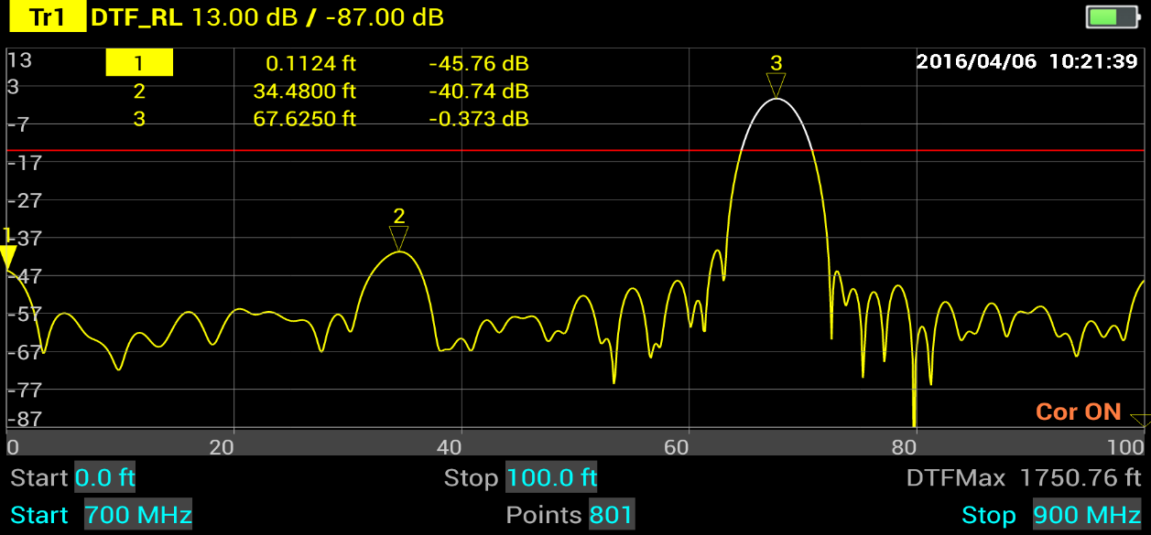
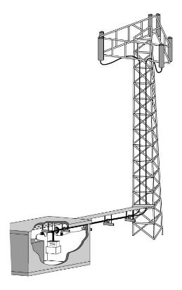
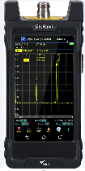
DTF – Interpreting Traces
Analyzer Connection
Open
Non precision barrel
Feed Line
Feed Line
Notes:
This is the distance to fault sweep of the diagram in the previous slide. The feedline is terminated in a precision open. The open at the end of the transmission line causes the noise floor to rise.

Slide 15
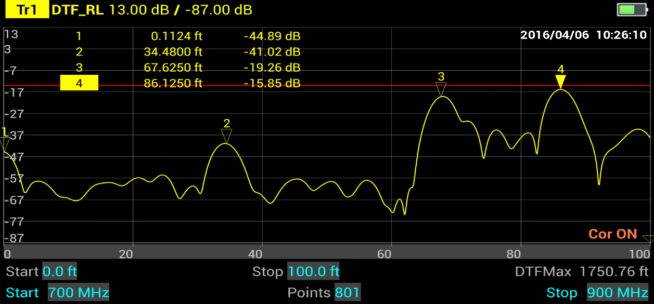
DTF – Interpreting Traces
Antenna
Analyzer Connection
Non precision barrel
Connection to Antenna
Feed Line
Feed Line
Notes:
This is the same sweep as the previous slide except that the precision load was removed and the line was terminated with an antenna (Marker 4). What is Marker 2 showing?

Slide 16
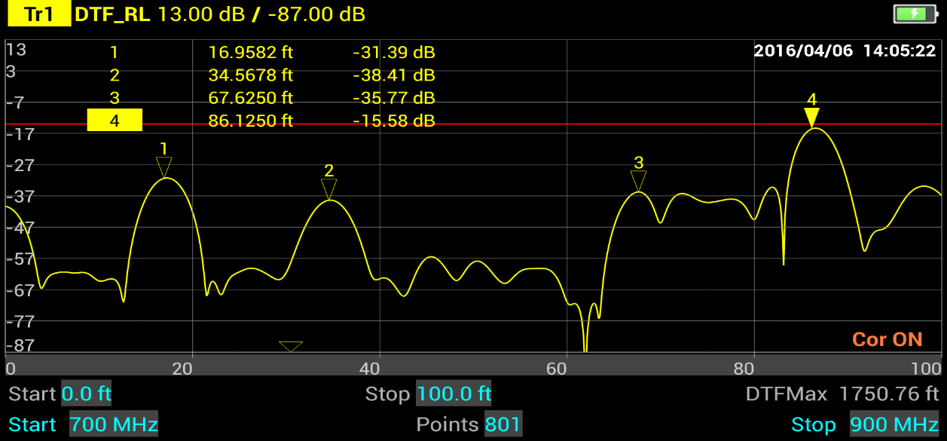
DTF – Interpreting Traces
Antenna
Analyzer Connection
Non precision barrel
Fault
Connection to Antenna
Feed Line
Feed Line

Slide 17
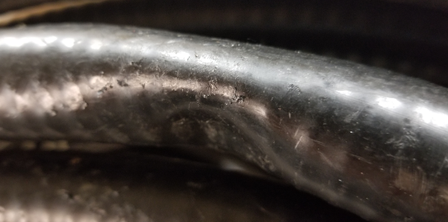
DTF – Interpreting Traces
The Fault on the previous slide ended up being a very large dent in the cable.
Non precision barrel
Fault
Connection to Antenna
Feed Line

Slide 18
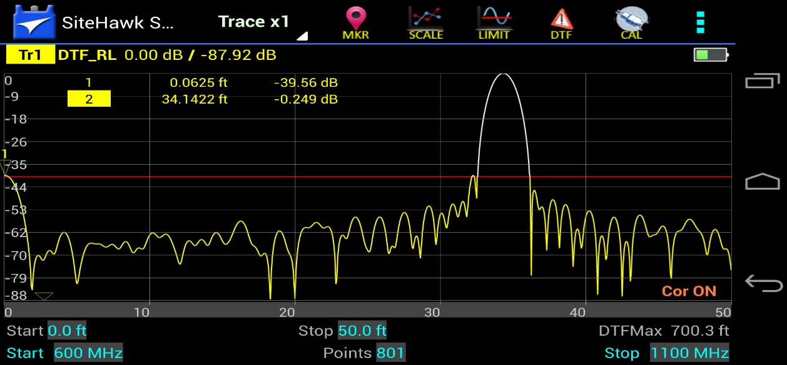
FDR - Interpreting Traces
Locate End of the Transmission Line
Short
Analyzer Connection
2
Feed Line

Slide 19
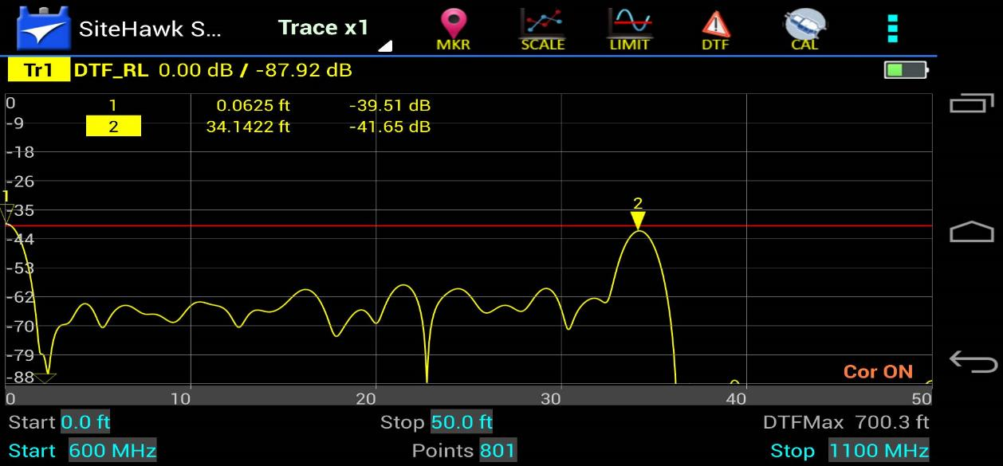
FDR - Interpreting Traces
Locate End of the Transmission Line
Short
Analyzer Connection
2
Feed Line
Precision Load

Slide 20
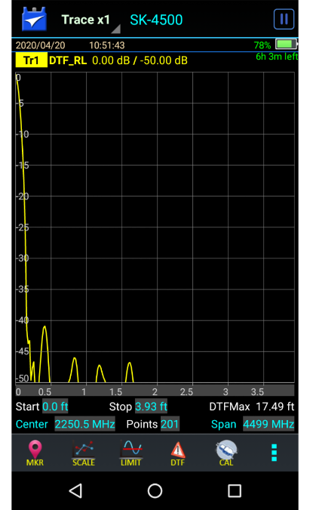
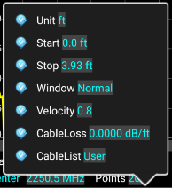
Tips for Setting up a DTF Sweep
Why can’t I set a Stop Distance more than 17.49 ft?
The Max Distance the SiteHawk can see into a cable
is based on 3 factors:
Frequency Span
Data Points
Vp
DTFMax
Tap here to display Center frequency and Span
4499 MHz
201
.8
17.49 ft

Slide 21
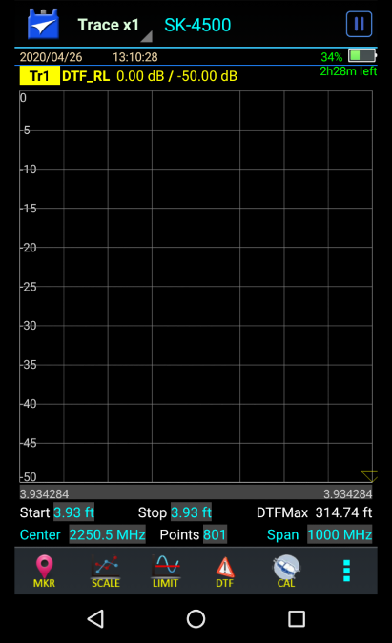
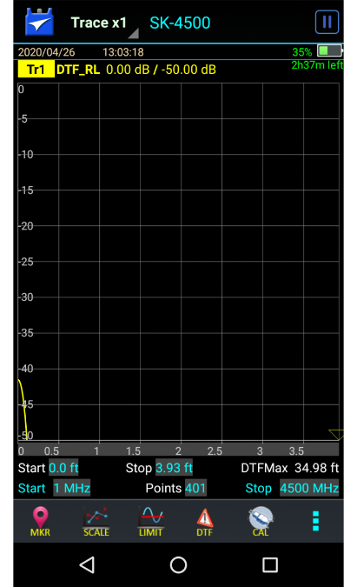
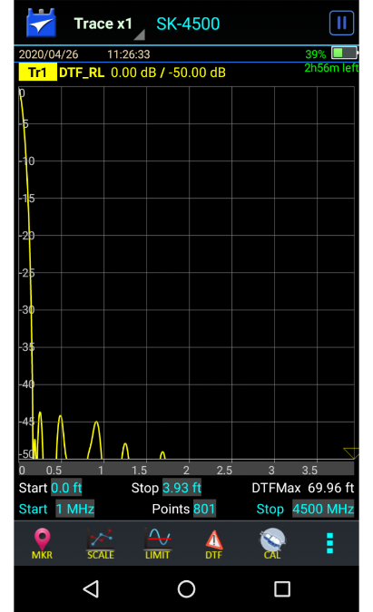
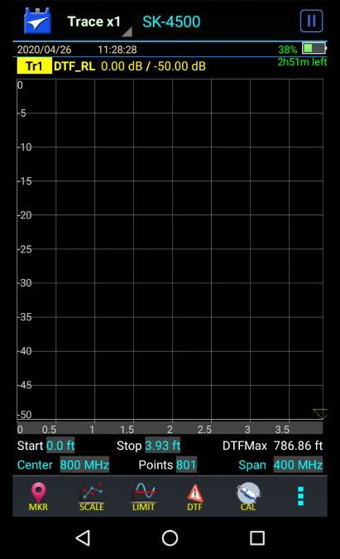
Tips for Setting up a DTF Sweep
The Vp is a Cable Spec and shouldn’t be changed.
Choices are to increase Data Points or Narrow Frequency Span.
Increasing the Data Points to 401
Increases the DTFMax to 34.98 ft
Increasing the Data points to 801
Increases DTFMax to 69.96 ft
Narrowing the Frequency Span to 1000 MHz
Increases DTFMax to 314.74 ft
Narrowing the Frequency Span to 400 MHz
Increases DTFMax to 786.86 ft

Slide 22
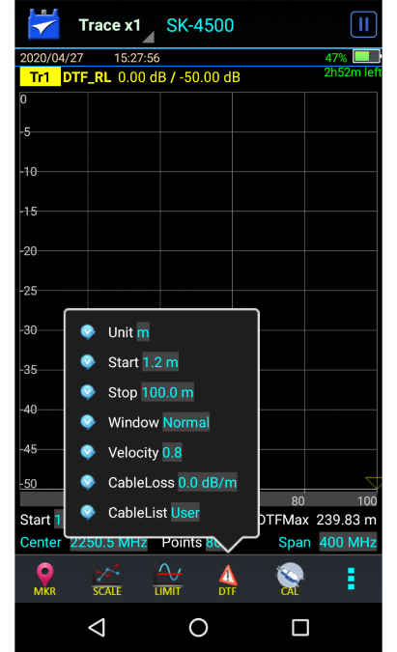
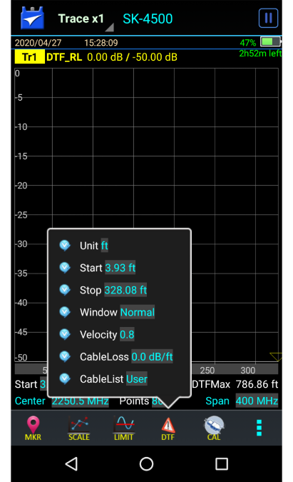
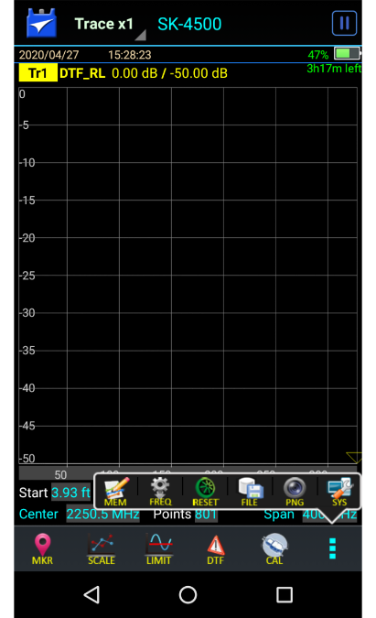
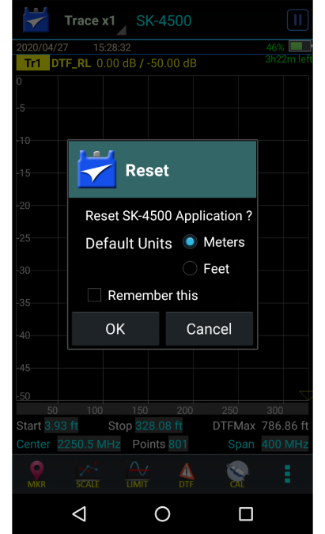
Don’t fall for this one
but it displays 328 ft.
I entered my stop distance of 100 ft,
Double check your DTF units prior to setting stop distance.
If it was set to meters, and you entered 100,
and then set your DTF units to feet,
it actually recalculated from 100 m to 328.08 ft.
Remember to set your DTF units first.
Another helpful hint.
When resetting to factory default
You are prompted to set the distance units, so this would be a good time to do it.

Slide 23
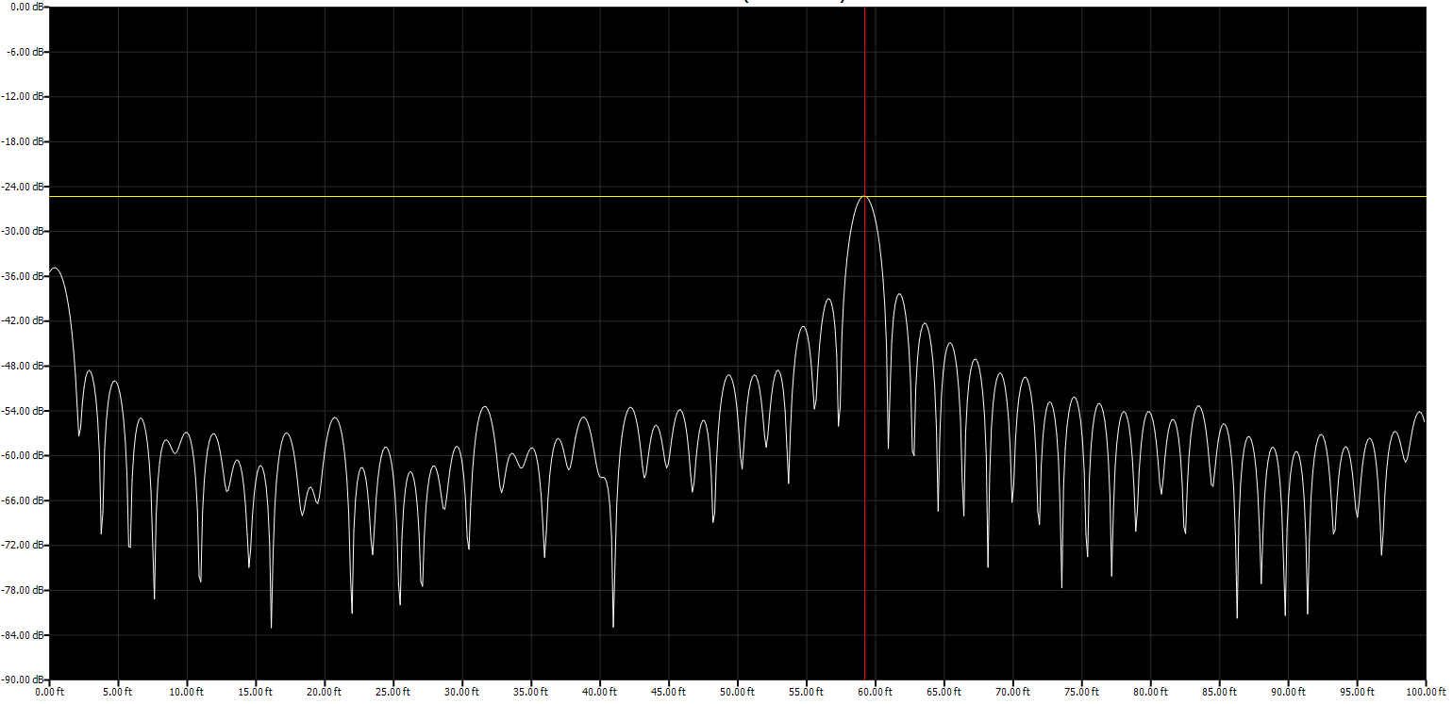
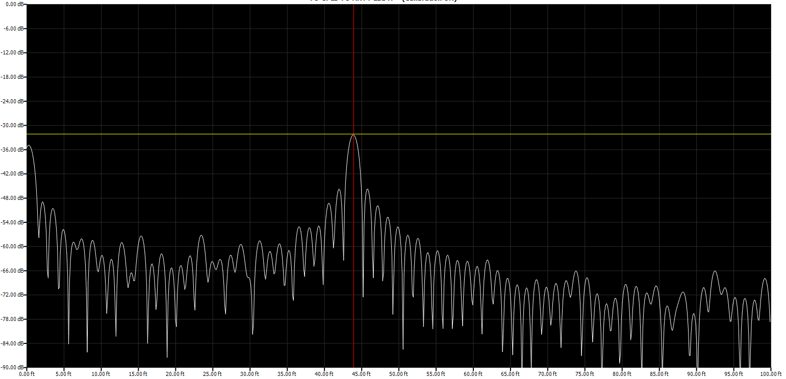
Watch Cable Information
Be careful when entering Velocity of Propagation manually.
Correct Vp shows
Distance at 59 ft
Incorrect Vp shows
Distance at 43.9 ft

Slide 24
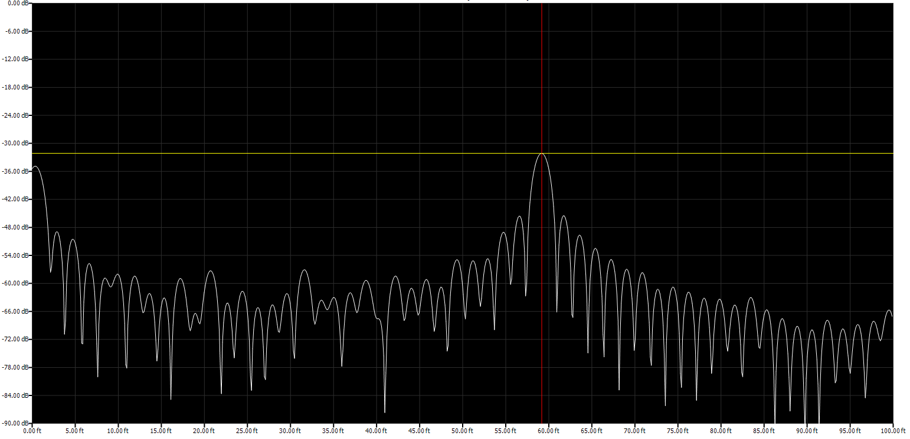
Watch Cable Information
Be careful when entering CableLoss manually.
Correct CableLoss shows amplitude at -32dB
Incorrect CableLoss shows amplitude at -25dB

Slide 25
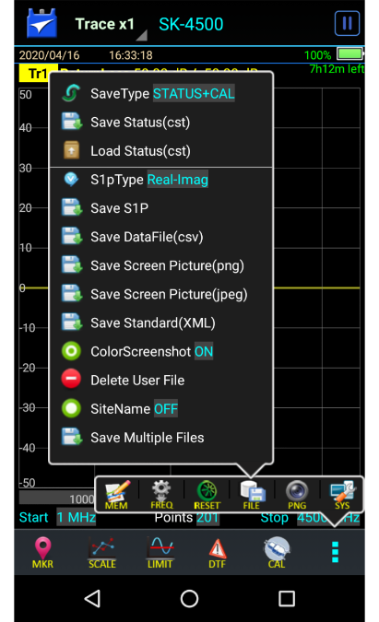
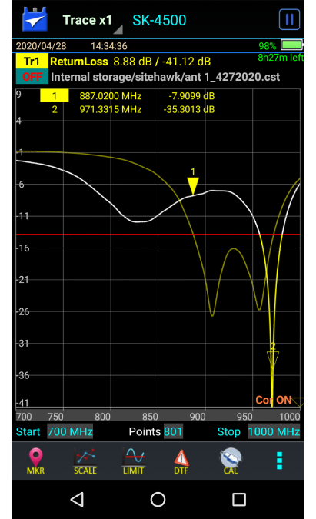
Tips for Saving files
Files can be saved on the SiteHawk in several formats for
future use.
Setup files (.cst) can be saved and loaded
to save time in programming the unit.
.S1P files are imported into the SiteHawk PC Tool
png and jpeg files are screenshots of your sweeps.
.cst files can be loaded to overlay a live trace
on a saved trace
Saving these files requires a separate operation for each.

Slide 26
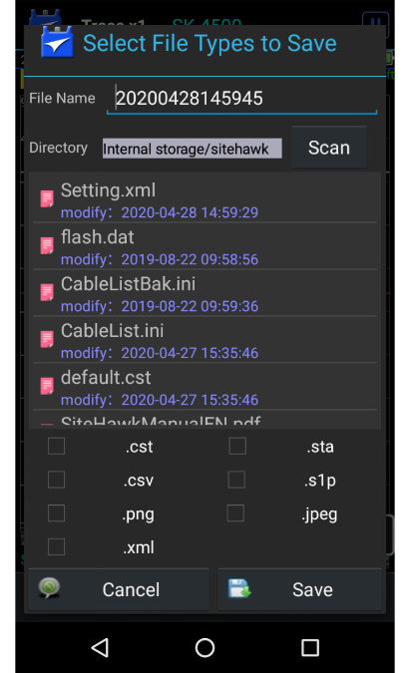
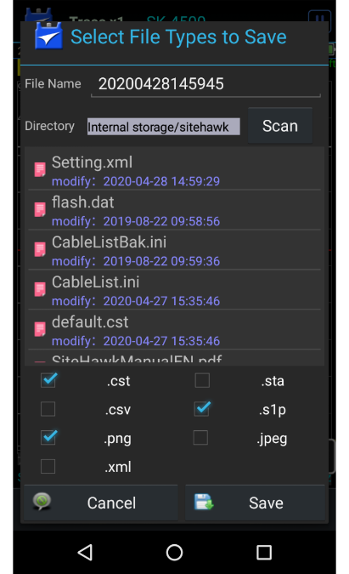
Tips for Saving files
Selecting Save Multiple Files allows one operation
for several file types.
Check the boxes for the file type to be saved.
Enter your filename.
Tap Save.
Your selected file types are saved with the same name
and correct file extension.
One save operation.

Slide 27
Recap
We discussed
What is distance to Fault?
Set up for Distance to Fault
What do I need to know?
How to interpret a sweep
Tips and best practices

Slide 28
For more information please contact:
sales@birdrf.com
For technical support & questions, please contact:
AppEngineering@birdrf.com

