Slide 1
Cable and Antenna Measurement Basics

Slide 2
Training Agenda
Segment 1:
Today’s Webinar Topics
Solving the problem - Cable & Antenna key measurements
RF Basics for Antenna System Troubleshooting
Key features of a Cable and Antenna Analyzer
Importance of regular calibration -Why and How
Segment 2: Next Week
All about DTF Distance to Fault
Set up for Distance to Fault
What do I need to know?
How to interpret a sweep
Tips and Best Practices

Slide 3

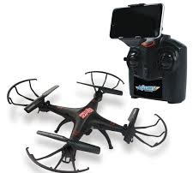
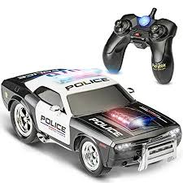
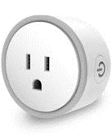
What is changing?
Over the last 20+ yrs., the use of Radio Frequency Energy as a communication medium has exploded.
Digitally encoded signals
equipment is causing the radio spectrum to become congested.
Frequency re-use in the broadcast television and radio bands has opened up more possibilities.
Unlicensed products from toys to home
networking systems has exploded.
WiFi,
TDMA,
Bluetooth,
Digital TV,
Digital FM Radio,
GPS,
3G,
4G,
and
5G

Slide 4


Finding the Problem
All of these systems have put more pressure on the RF technician to be able to:
Spot potential interference problems.
Maintain systems that operate to expected standards.
Avoid causing interference to other services
Finding signal in the noise

Slide 5
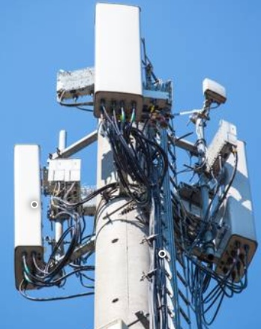
Identifying the problem
Radio Frequency (RF) systems employ feed lines that are often not easily accessible.
Some consist of hundreds of feet of coaxial feed lines clamped to a tower, held together with adapters and connectors, attached to the antenna hundreds of feet in the air.
Add in abnormalities:
Bullet holes
Animal remains
Ice and Snow
Incorrect installation
How do we fix this?
By using a Cable and Antenna Analyzer to perform “Key Measurements.”

Slide 6
Key Measurements for Cable & Antenna Analysis
Measure/Match - Determine if there is a problem with your system - System impedance vs frequency is plotted on the display. Results in VSWR or Return Loss.
Distance to Fault (DTF)-Pinpoint the location of the problem – Distance vs frequency is plotted on the display. Results in VSWR or Return Loss.
Cable Loss – Determine how much power is being lost within the line or in individual components. The measurement may be called insertion loss, cable loss or attenuation and is a manufacturers specification.

Slide 7
Benefits of Line & Antenna Sweeping
Tests the overall integrity of an antenna system installation.
Verifies that antenna system components meet manufacturer’s design specifications.
Verifies that the antenna system meets the system engineer’s design specifications.
Pinpoints the location of antenna system problems prior to usage.
Confirms system integration and antenna performance.
Test
Verify
Pinpoint
Confirms

Slide 8
Why do I need a Cable & Antenna Analyzer?
System Commissioning
Antenna system commissioning is a process whereby faults and potential faults are eliminated before they compromise the system, prior to the system being put into use. It is structured and methodical, but also thorough, with the goal of having 100% system uptime for effective communications.
Troubleshoot Existing Antenna Systems
When there is a problem, quickly read the system and determine where the problem is.
Preventive Maintenance
Perform sweeps, and compare to the sweeps saved during commissioning, to see where changes may have occurred and fix potential problems before they take the system down completely.

Slide 9
RF System Components & how they work together
All components in a feed line system, including the Antenna, must be “Matched” in their characteristic impedance.
What is the characteristic impedance we are interested in?
Impedance Matching, Measure Match, or simply Match, all refer to the same measurement.
How well each of the components within a system are matched to the rest of the components.
This is measured in VSWR or Return Loss.
50 Ω

Slide 10
Coaxial Cable Impedance
Feed lines are designed for a specific impedance.
Impedance is defined as the total passive opposition to the signal.
Impedance is a function of the diameters of the center conductor,
to the outer conductor,
  and the dielectric constant of the insulating
  material between them.
Understanding what causes impedance changes is half way to solving feed system problems.
Changes in any of these dimensions will change the impedance of the feed line.
Outer Conductor
Center Conductor

Slide 11
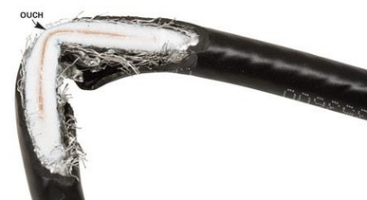
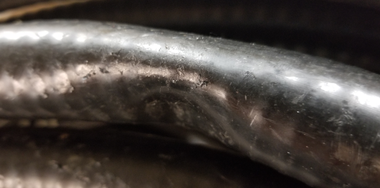
Maximum Power Transfer
One of the fundamental laws of physics states when:
Load resistance or impedance is = to the source's internal resistance or impedance.
Maximum power will be developed in the load.
Coaxial cable impedance is a complex function of the ratio of the diameters of the conductors.
If the diameter ratio changes, the impedance of the cable will change and the power transfer changes also.
  Such as from a dent, kink, deformation, too sharp of a bend radius, etc.

Slide 12
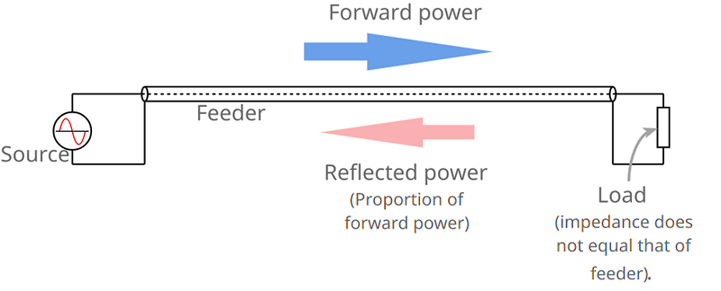
System Components & how they work together
If the transmission line (coax) and load (antenna) impedances are not the same, (mis-matched), power is reflected from the load in the form of a wave traveling back to the source.
Waves moving in the other direction (i.e., towards the load) interact, resulting in a series of standing waves along the length of the transmission line.
A short or open causes 100% of the power to be reflected.
Measured in VSWR or Return Loss (in dB).

Slide 13
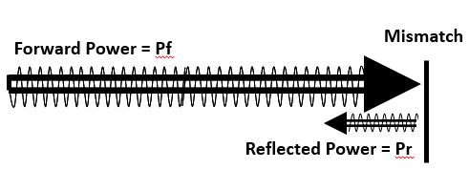

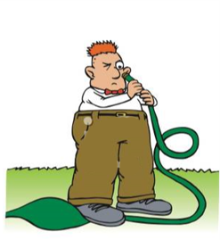
What is Mismatch?
Think of a garden hose with no obstructions (no reflections).
What happens when the hose is kinked, or the transmission line is shorted?

Slide 14
VSWR vs Return loss
What is it? What does it mean?
VSWR
Return Loss
Comments
1.0:1
-∞
Perfect match. 100% of the power is delivered to the antenna (not possible).
1.43:1
-15 dB
Very little reflected power. 96.84% of the power delivered to the antenna.
1.5:1
-13.98
Very little reflected power. 96% of the power is delivered to the antenna.
2.0:1
-9.54dB
88.9% of the power delivered to the antenna.
10.0:1
-1.74dB
Very poor match. Only 33% of the power delivered to the antenna.
Notes:
Again, VSWR and Return Loss are different ways of presenting the same information, how good is the match within a system. Both indicators are developed using forward power and reflected power. When using VSWR, the lower the first number, the closer it is to 1.0, the better the system is performing. Return Loss is a ratio, expressed in negative decibels, so the higher the absolute number, ignoring the negative sign, the better. The system design engineer will set the level of what are acceptable values using manufacturer’s specifications as a starting point.
RF technicians and engineers are given the task of getting all of the power out of the transmitter and into the antenna. One of the first methods available is to measure all system components to determine their “match”, with match being a measurement of how well everything fits together. Some losses in systems cannot be corrected such as cable loss, the loss of RF power strictly due to resistance in a feed line or cable.
Maximum power transfer occurs when source and load impedance match. The standard for much of the RF industry is systems with 50 ohms of impedance. All the parts of a system should have the same impedance. When all parts of the system match, the maximum number of calls will be carried.

Slide 15
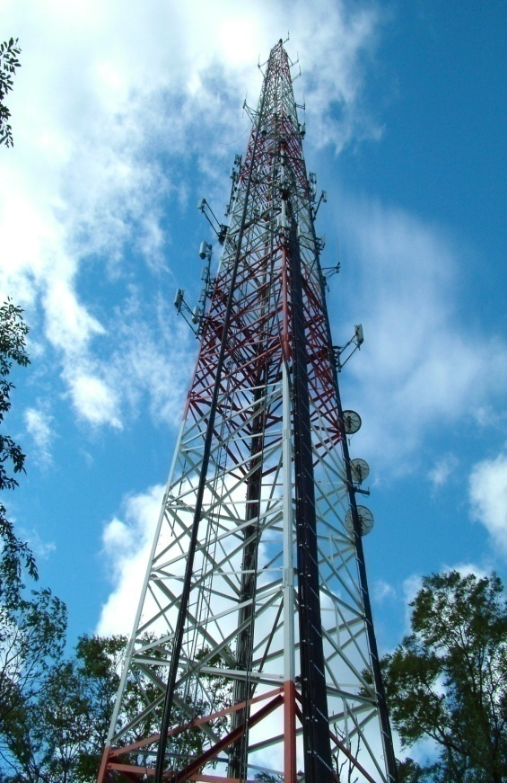
What causes an impedance mis-match?
  Bad or loose connectors
  Bad jumpers
  Bend radius of the cable is too tight
  Water in the feed line or connectors
  Bad antenna
  Clamps tightened too tight
  Poorly or improperly installed grounding kit
  Antenna installed too close to tower or other antennas
  Bad lightning protectors
  Wind damage to connectors and cable
  Corrosion at connector interfaces
  Low quality connectors
  Poor center pin contact or intermittent center pin contact
  Dents in the feed line
  Gouges
  Bullet holes in the feed line, connectors, antenna, etc.
Can you add to this list?
Notes:
This is a “partial list”. Anything that damages any part of the feed system will change the impedance of the components. Lightning strikes, tower vibration set up by constant wind, squirrels and birds, cable that has been run over while stretched out on the ground, the neighbor that “doesn’t like the hum”, and hundreds of other things impact the impedance of the system and with it, the operating efficiency.

Slide 16
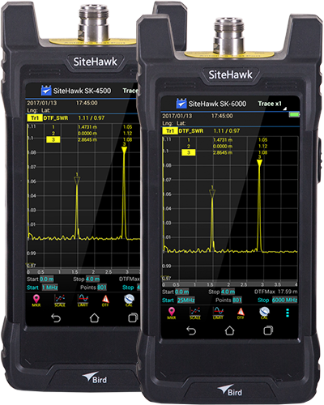
Key Features of Analyzers
Features
Applications
Measure/Match – Frequency Response
Results in a highly reliable assessment of the health of critical components in your system.
Cable Loss
Measures Insertion Loss of the cable system over a given frequency range.
Fault Location or DTF mode
Indicates VSWR or Return Loss levels at each point along the cable and antenna system length
Cellular Networks 3G, 5G (2.4, 4.2 GHz & 600, 850 MHz)
Broadcast
Paging
Government
Tactical Military
Microwave
Public Safety
Trunking, TETRA
Network Coverage WLAN, WLL (802.11)
PCS/DCS, CDMA, GSM and LTE Protocols

Slide 17
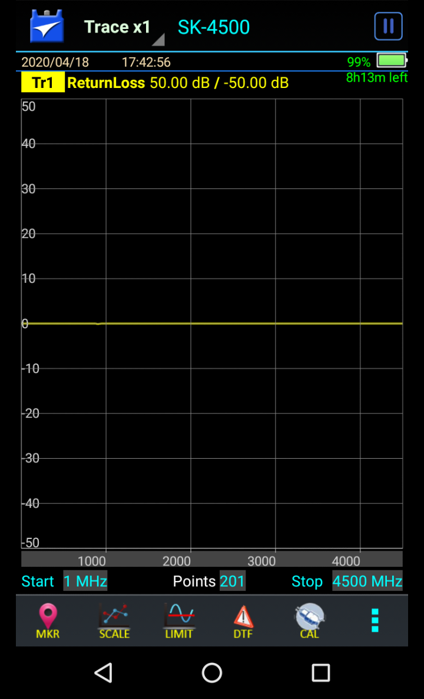
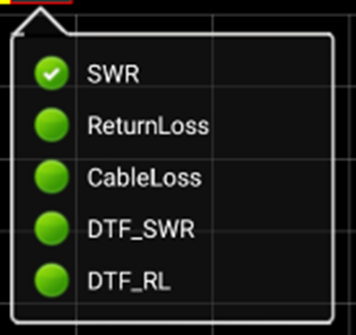
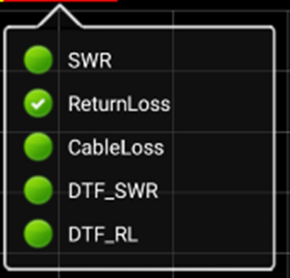
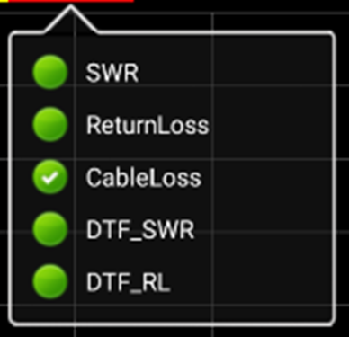
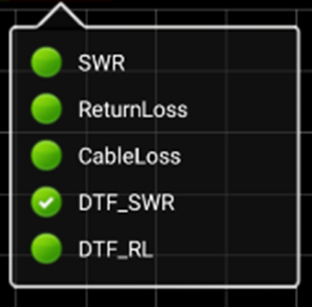
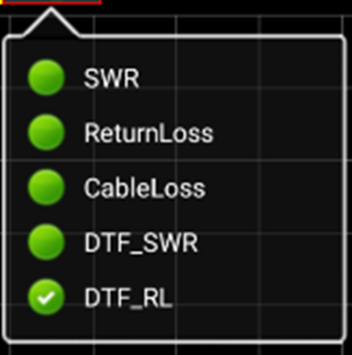
Key Features of a Cable & Antenna Analyzer
Utilizing our SiteHawk Analyzer we can show you key functionality.
Select Mode of operation by Tapping the screen here
SWR Measure/Match sweep. Frequency response in VSWR.
Return Loss Measure/Match sweep. Frequency response in Return Loss.
Cable Loss One way measurement showing loss from beginning
of the cable to the end. Results in Return Loss.
DTF_SWR Distance to Fault. Pinpoints exactly where the fault lies.
Results in VSWR.
DTF_RL Distance to Fault. Pinpoints exactly where the fault lies.
Results in Return Loss.

Slide 18

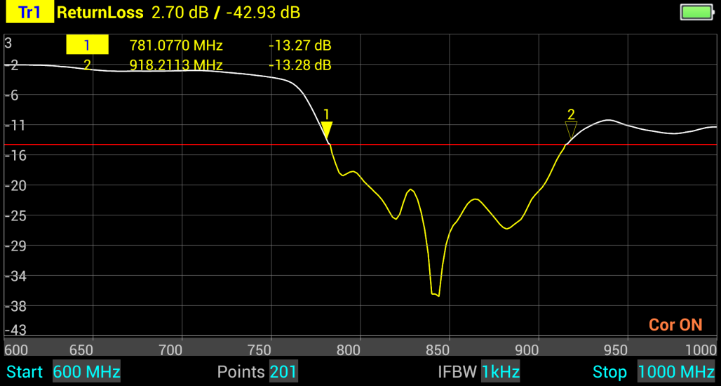
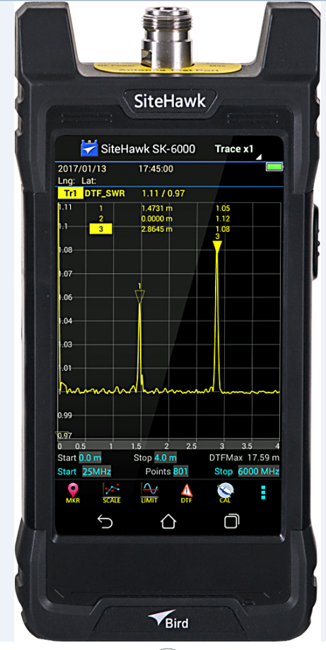
Antenna Sweep – Return Loss
Antenna bandwidth can be defined as its usable frequency range. It is equal to the difference between the upper and lower usable frequency.
The frequency limits are determined by the antenna’s VSWR/Return Loss.
Markers
Limit Line
-14dB
Antenna Resonant Band

Slide 19
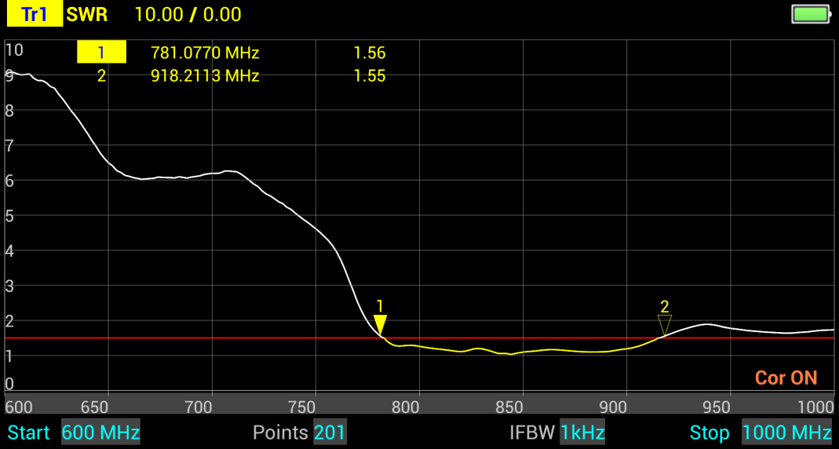
Antenna Sweep – VSWR (or SWR)
Antenna sweep in SWR
Markers
Limit Line
1.5
Antenna Resonant Band

Slide 20
Cable Loss
Coax cables, connectors and other devices have loss.
The loss is due to skin effect, radiation, leakage, conductor resistance, and dielectric losses.
Cable loss is specified by the manufacturer, usually at one or two particular frequencies.
Check manufacturer specifications for more details.

Slide 21
Distance to Fault - DTF
DTF is a measurement of how far from the test point a fault occurs, the distance from the test point to a problem in a system.
DTF includes all system components and displays the match characteristics of all the components on the screen of the analyzer in either VSWR or RL units.
DTF can check components individually or as an entire system.
Instead of “hand-over-hand” checking of the feed line up a tower, the device will give a distance to the problem.
The field technician might still have to climb the tower, but he/she will have a much smaller area to check to find the fault.

Slide 22
Prepare for Antenna Sweeping
What do we need to do?
Enter the frequency range of the antenna (set the range wider than the specified range).
Calibrate your analyzer
Attach the antenna.
What does the sweep show?
Frequency response of the antenna.

Slide 23
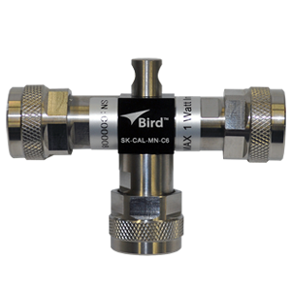
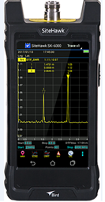
Calibration Example
Accurate measurements can only be taken with the analyzer if the calibration is accurate.
Calibration tells the unit where to begin measurement.
It defines where the SiteHawk ends and the attached system begins.
Calibrate here, measurement begins here.

Slide 24

Calibration Tips
CALIBRATION TIP:
Use a test cable in your measurements.
Adding a test cable allows you to extend the test port to reach those hard to get to places.
The addition of a test cable, or changes in the length of the test cable, will affect readings taken in Distance to Fault measurements.
When using a test cable calibrate to the end of the cable.
Calibrate here, measurement begins here.
Cal combo
1.5m RF Test Cable

Slide 25
Important To Remember
Changes in the frequency range entered will impact the cal, turning off the “Cor ON” indication.
Prior to performing a Measure/Match, Cable Loss or Distance to Fault sweep, it is very important to Calibrate the unit using a Precision Cal Combo.
The Cal Combo is a precision piece of equipment and must be handled with care.
If it is dropped, the connectors could be deformed and not connectable to the analyzer, or the internal resistor could be broken, making the device unusable.

Slide 26
Recap
We discussed
Cable and Antenna basics
Key measurements
Key measurement examples
Importance of Calibration

Slide 27
For more information please contact:
sales@birdrf.com
For technical support & questions, please contact:
AppEngineering@birdrf.com

