Slide 1
VPM3 Virtual Power Meter for Windows™ Bird RF Meter Android App Mike Gathergood Bird Technologies, EMEA +44 7557 368490 mgathergood@birdrf.com July 2020

Slide 2
VPM3 and Bird RF Meter App
Bird’s VPM3 software allows a Windows™ computer to work as a precision RF power meter in conjunction with any of the following RF sensors. The Bird RF Meter App affords an Android phone or tablet the same capability:
501x Wideband Power Sensors, including 5012D, 5016D, 5017D, 5018D and 5019D
7020 Basic Power Sensor family, including 7020-1-010101 and 7020-1-030301
5010B (RS-232) and 5014 (USB) Directional RF Power Sensor

Slide 3
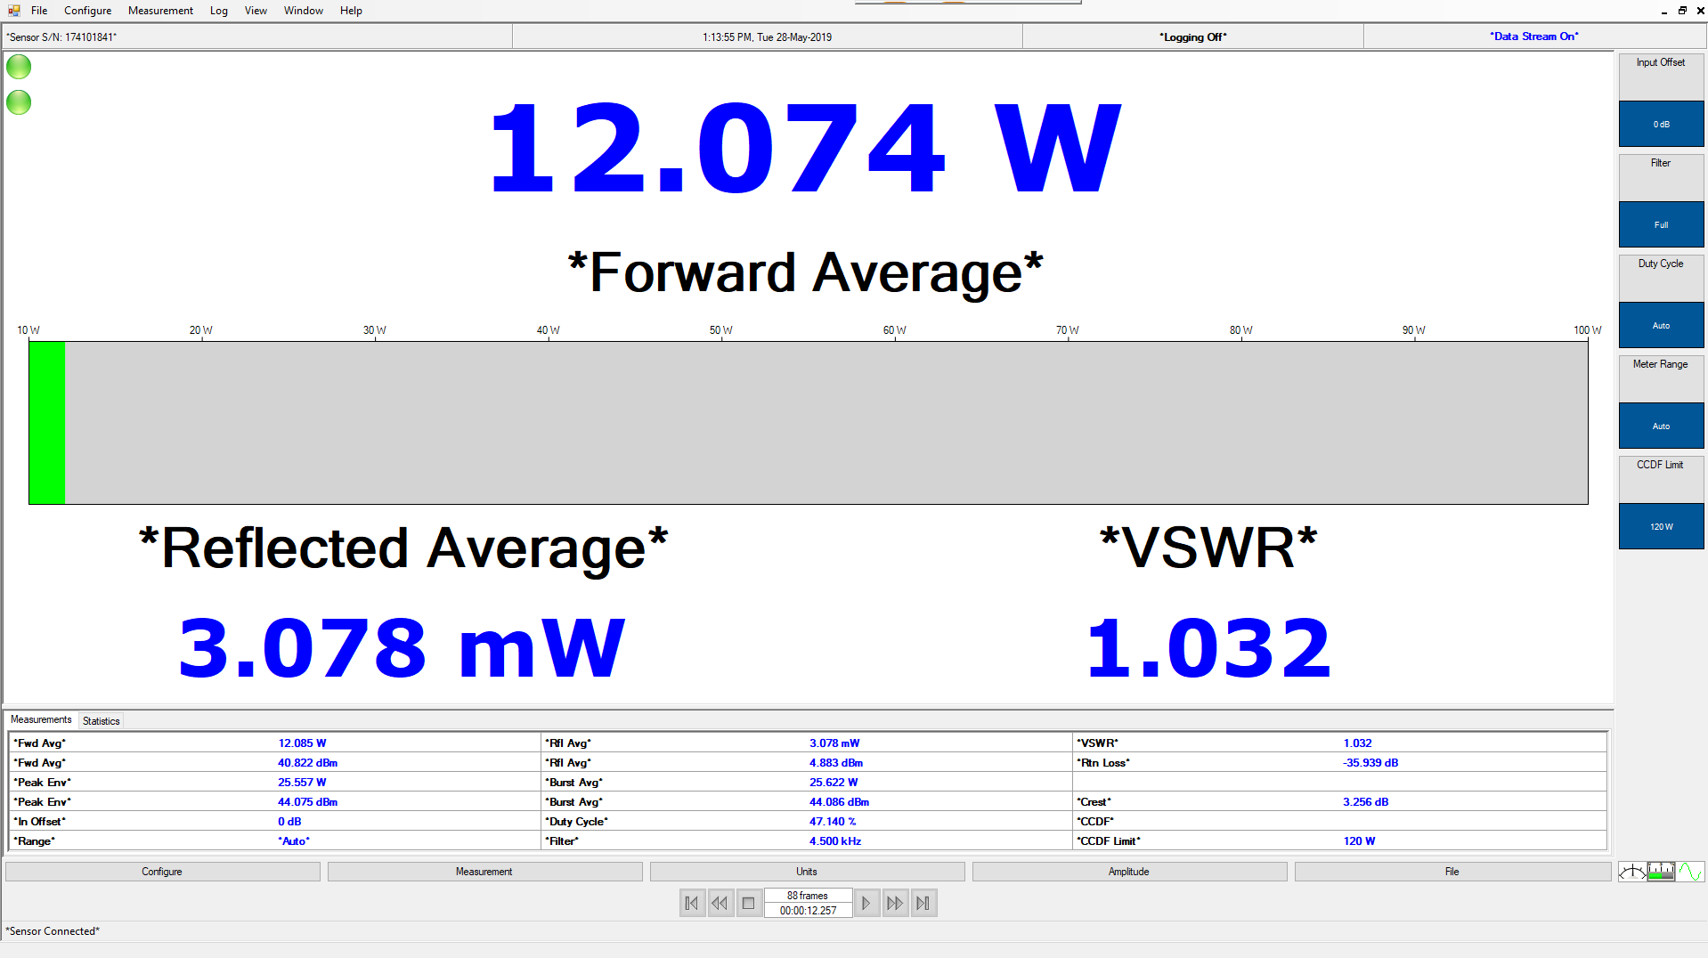
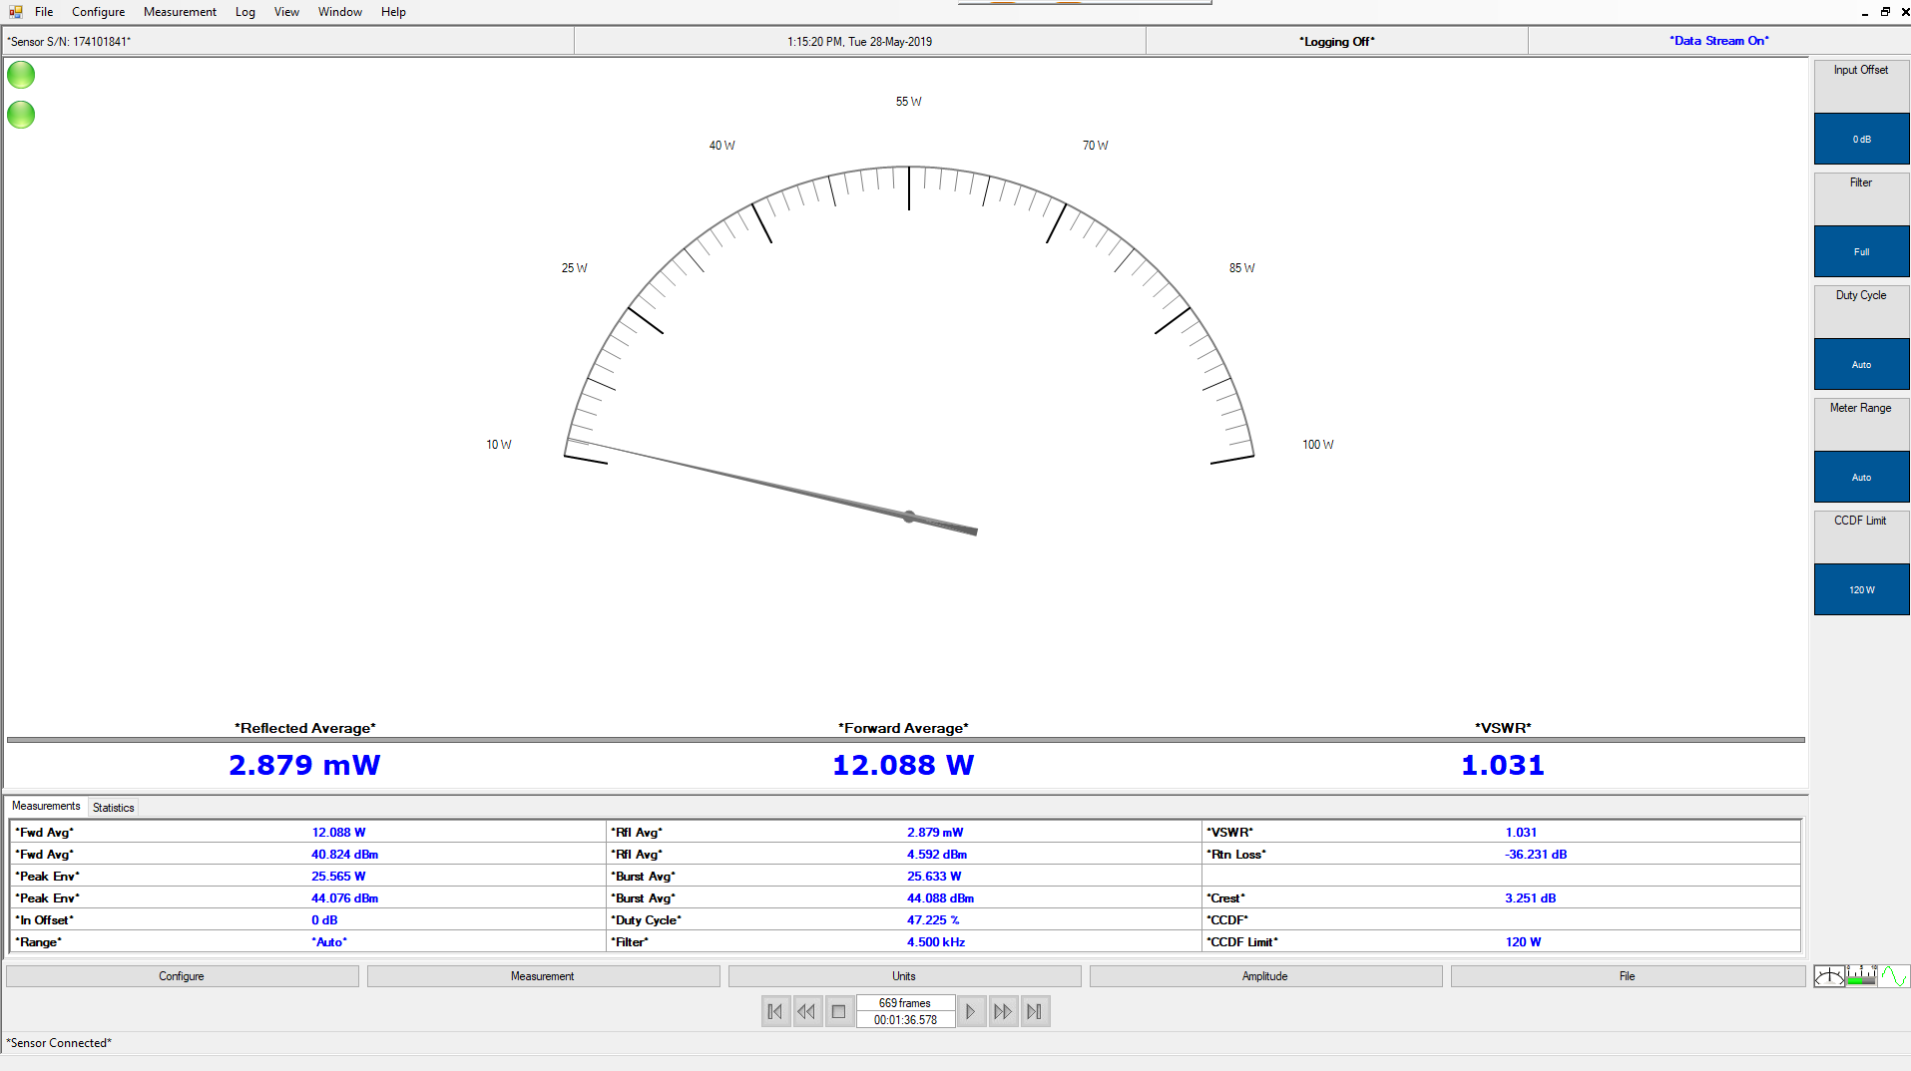
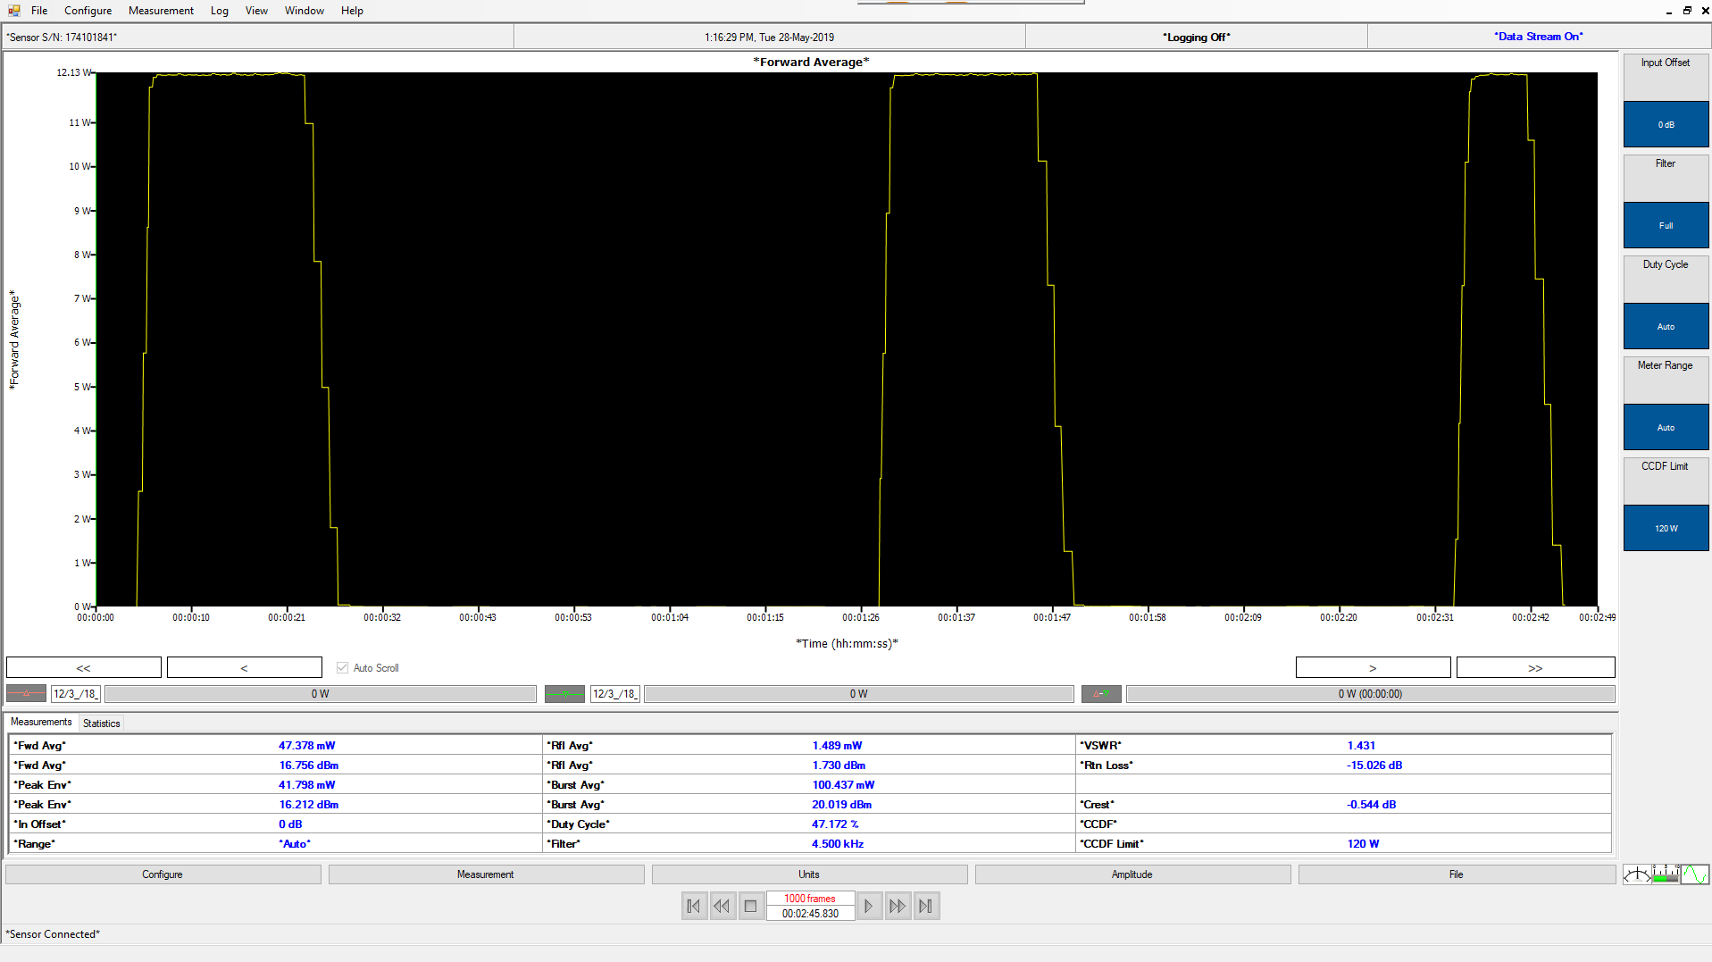
VPM3 and Bird RF Meter App
VPM3
Multiple display functions; digital, analogue or time domain
Can handle up to 50 sensors simultaneously (subject to connectivity of host computer)
Displays following functions (subject to sensor capabilities); VSWR, Peak Power, True Average Power, Burst Power, Crest Factor, CCDF
Data logging with playback of saved files
Free of charge from Bird website

Slide 4
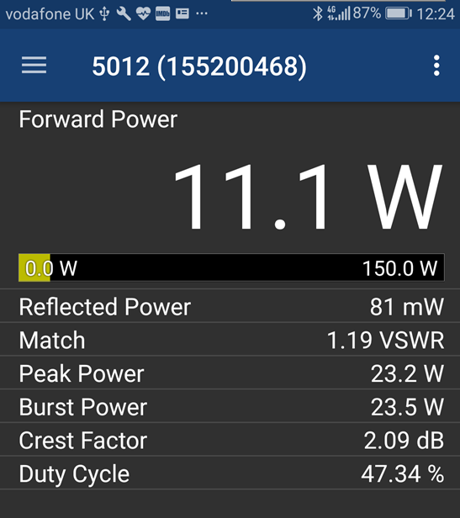
VPM3 and Bird RF Meter App
Bird RF Meter App
Displays following functions (subject to sensor capabilities); VSWR, Peak Power, True Average Power, Burst Power, Crest Factor, CCDF
Hardware must support On-The-Go host functionality
Free of charge from Google play store
Pre-loaded on SiteHawk and SignalHawk

Slide 5
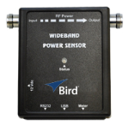
VPM3 and Bird RF Meter App
Wideband Power Sensor Family
Measures True Average Power, Peak Power, Burst Power, Duty Cycle, VSWR, Return Loss, Reflection Coefficient, Crest Factor and CCDF
Works with 5000-XT Digital RF Power Meter
Also works with VPM3 Windows™ software and Bird RF Meter Android App
4% accuracy for average forward power
5012D, 0.35-4GHz, 150mW-150W, 400W peak
5016D, 0.35-4GHz, 25mW-25W, 60W peak
5017D, 25-1000MHz, 500mW-500W, 1.3kW peak
5019D, 25-1000MHz, 100mW-100W, 260W peak
5017D-AV is a special version for Avionics
applications, covering 100MHz to 1.3GHz,
which includes VOR, Ground-to-Air, TACAN
and DME frequencies

Slide 6
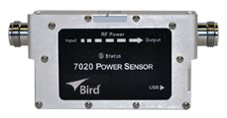
VPM3 and Bird RF Meter App
Basic Power Sensor Family
Measures True Average Power and VSWR
Works with 5000-XT Digital RF Power Meter
Also works with VPM3 Windows™ software and Bird RF Meter Android App
4% accuracy for average forward power
7020-1-010101, 0.35-4GHz, 150mW-150W
7020-1-030301, 25-1000MHz, 500mW-500W

Slide 7
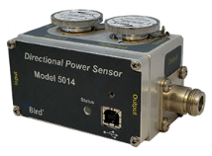
VPM3 and Bird RF Meter App
5014 Directional Power Sensor
Measures True Average Power, Peak Power and VSWR
Works with 5000-XT Digital RF Power Meter
Also works with VPM3 Windows™ software and Bird RF Meter App
Interchangeable (QC) RF Connectors, includes N, BNC, TNC, UHF, SMA, 7/16mm DIN, etc…
Use DPM elements for True Average Power with 5% accuracy
Use Model 43 elements for Average (5% FSD) or Peak Power (8% FSD)
Full list of elements on Bird website

Slide 8
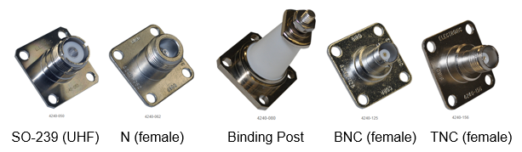
VPM3 and Bird RF Meter App
5014 RF Connectors
Supplied with N female connectors by default
Connectors can be changed in seconds with just a screwdriver
Full list may be found on Bird website, www.birdrf.com

